Slide 2
CANCER
Definition: Tissue consisting of a heterogeneous population of cells that differ in biological characteristics and potential for self renewal. (Reya et al, 2001)
An abnormal mass of tissue the growth of which exceeds and is uncoordinated with that of normal tissues and persist in the same extensive manner after cessation of which evoked the change. (Robbins 7th edition)

Slide 3
EPIDEMIOLOGY
India (2004 ICMR) no. of cases diagnosed:
MALE
FEMALE
4,56,232
515354
No. of death due to cancer :
MALE
FEMALE
4,28,525
3,90,809
New cases diagnosed in US : 16,90,000
No. of death : 5,77,000

Slide 4
TREATMENT
Radiotherapy
Chemotherapy
Surgery
Complementary and alternative medicine (CAM)
Palliative therapy

Slide 5
Positive-ness by Chanting
Causes secretion of Melatonin which gives message of well-being to the body.
Chanting starts and accelerates the secretion of some stimulants which intern through hormones protects the cell from free radicals (ROS) reactive oxygen substances.
Possibly it may boost immune system to correct the cancerous cells to normal.
Recitation also inhibits cancerous cell metabolism there by production of poisonous protein substance gradually becomes less and lesser.

Slide 6
Comparative Study of Patients with Chanting-Study Group of 20
Patients without chanting-control group is being carried out.
Four parameters are studied :-
Quality of life-objective
Quality of life questionnaire was filled on date of start of chanting-17th July 2014.
Then again it was answered by patients after 21 days on 7th August 2014 so the difference of total of QOL between two dates showed significant improvement +14 was result achieved on an average.

Slide 7
PALLIATIVE CARE IN TERMINALLY ILL CANCER PATIENTS IN SNEHACHAL: Best cases Vs. Worst Case: Scenario reports.

Slide 8
COMPLIMENTARY AND ALTERNATIVE MEDICINE
The worldwide use of Complementary and Alternative Medicine(CAM) has grown considerably in the past 20 yrs.
According to WHO in 2013, it is extremely important to create conditions for the correct and appropriate use of CAM which if used correctly can contribute to the protection and enhancement of citizen’s health and wellbeing.

Slide 9
COMPLIMENTARY AND ALTERNATIVE THERAPY
Healing
Acupuncture
Hypnosis
Meditation
Aroma therapy
Herbal-Chinese and Ayurveda
Homeopathy
Reflexology

Slide 10
SPIRITUAL HEALING
It is a drugless therapy to cure all types of diseases.
Jain method of healing by
“Bhaktamar Strotra”

Slide 11
BHAKTAMAR STOTRA
Bhaktamar Stotra is composed by Acharaya Maantungaji has a very high place of pride in Jain holy literature.
Devotee Maantungacharaya while reciting the attributes of the vulnerable detached Lord Adinath in this devotional poetic Stotra expressed the desire to become like him.

Slide 12
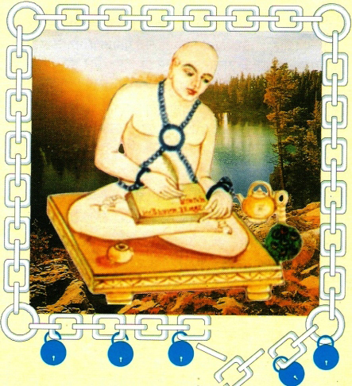
Acharya Maantungaji Maharaj

Slide 13
Prof. Herman Jacobi (Dr. Phil.) from Germany had quoted in 1875, “ Among the almost numberless productions of the ecclesiastical muse Maantunga’s Bhaktamar Stotra has held during many centuries, the foremost rank by the unanimous consensus of the Jainas. And, it fully deserves its great popularity by its religious pathos and the beauty of diction… Acharya Maantunga writes in the flowery style of classical Sanskrit poetry. Besides being a work of devotion, the Bhatamar Stotra has also the character of a prayer for the help in the dangers and trials under which men suffer. It is the perhaps this particular trait which greatly endeared the Bhaktamar Stotra to the heart of faithful”.

Slide 14
GOAL OF THE THERAPY
Improve quality of life
To relieve pain & other symptoms
To boost up the moral
To alter the emotional attributes of disorder

Slide 15
PLAN OF WORK
Selection of patient
The patient reporting to O.P.D. in various hospitals
Patient admitted in hospital or taken up in hospital.

Slide 16
INCLUSION CRITERIA
EXCLUSION CRITERIA
Cancer
Diabetes
Hypertension
Tuberculosis
Person having no faith in system of spiritual healing

Slide 17
TOOLS TO ACHIEVE OBJECTIVE
Patient selection
Consent of attending physician.
The patient counseling & evaluation of attitude
Disease evaluation
Treatment given – current status
Description of disease
Doctor’s remark on prognosis of patient

Slide 18
CONSTANTLY CHANTING 45TH SHLOKA
If we chant all the shlokas , continuity does not remain. 45 th shloka relates to incurable disease

Slide 19
ASADHYAROGA NIWARAKA YANTRA-45
Udbhuta bhishana jalodara bhara bhugnah,
shochyam dasha mupagatas chuta jivitasha I
Twat pada pankaja rajomrita digdha deha
Martya bhavanti dhvaja tulya rupa II45 II

Slide 20
MEANING OF SHLOKA NO.45
Person who is suffering from dreadful disease, prognosis of disease by Doctors is very poor - ascites, a type of cancer -
eg. - liver, stomach, breast, ovary, spillage in which stomach bloats up, morbid condition with family members loosing hope of life, attain good health and becomes like cupid by chanting shloka and applying holy water of yantra.

Slide 21
SCIENTIFIC ANALYSIS OF MANTRA
Music or sound therapy
Tranquility state

Slide 22
SOUND THERAPY
Everything has particular vibratory frequency .Every thought every word and every emotion.
Realizing this fact ,that SOUND is the most powerful element .
Our ancient sages developed the science of MUSIC or SOUND Therapy, called bio waves or mantra .collection of MANTRA is called STOTRA.

Slide 23
AT PHYSICAL LEVEL
Sound works with movement of tongue.
Hard palate forms 84 meridian points
Pronouncing MANTRA stimulates these meridian points which stimulates HYPOTHALAMUS to secrete neurotransmission fluids
Sound vibrations also received by the ear

Slide 24
AT PHYSICAL LEVEL
Sound Vibration
Ear
Electric signal
Frontal Lobe
Acoustic Bar
Acoustic Nerve
Various parts of Body
Lift his Spirit up
Bring Back beautiful movement
Make him deliriously happy
Sensation of energy flow head from base

Slide 25
TRANQUILITY – STATE OF PEACE
Stress
Stimulates Para ventricular nucleus of HYPOTHALAMUS that causes release of CRF (Corticotrophin release factor)
CRF affects Limbic system & stressful behavior & sympathetic activation occurs.
When it reaches to peak then excess runs downs through median eminence to pituitary gland to release ACTH
ACTH

Slide 26
ACTH will act on Adrenal cortex to release corticosteroids
When corticosteroids attain sufficient level then it stops secretion of CRF through FEEDBACK mechanism.
Stress response is stopped.

Slide 27
Tranquility – No response to internal or external stressful stimuli.
It means no CRF. Why & how CRF is not released ?
HYPOTHALAMUS has AN which cause release of GNRH at limbic system and has antagonistic behavioral effects of CRF. This is extra endocrine effect of GNRH.
Chanting of Mantra & meditation prevents thought process in mind & activates AN moreover GNRH inhibit release of CRF & hence no stress.

Slide 28
CASE STUDY
NAME OF PATIENT | NAME OF DOCTOR/HOSPITAL | DIAGNOSIS
Raghunath shambharkar | Dr .Ajay Mehta | Pyriform fossa carcinoma
Miss. Kanchan Bhujate | Dr. Ajay Mehta | Acute lymphoblastic leukemia
Mr. roopchand Gadpayle | Govt. Medical College Nagpur. | Squamous cell carcinoma
Mr. Pandurang Kangane | Snehanchal Hospice Nagpur | Dying patient of cancer

Slide 29
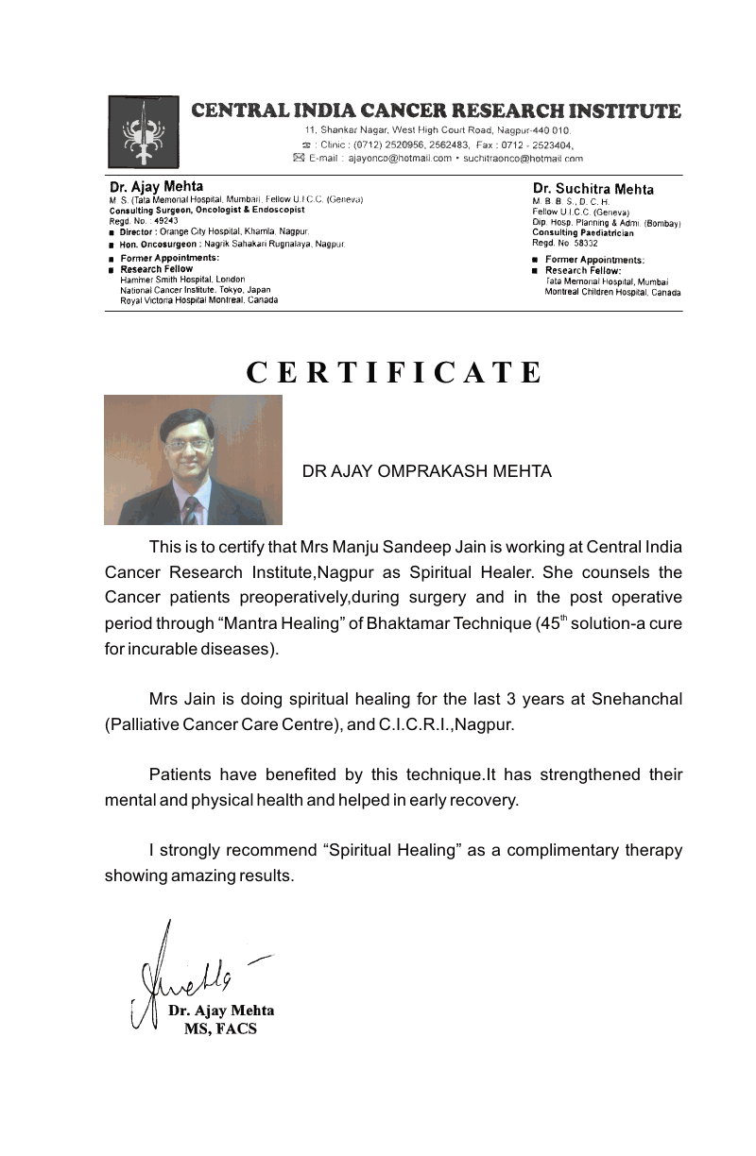

Slide 30
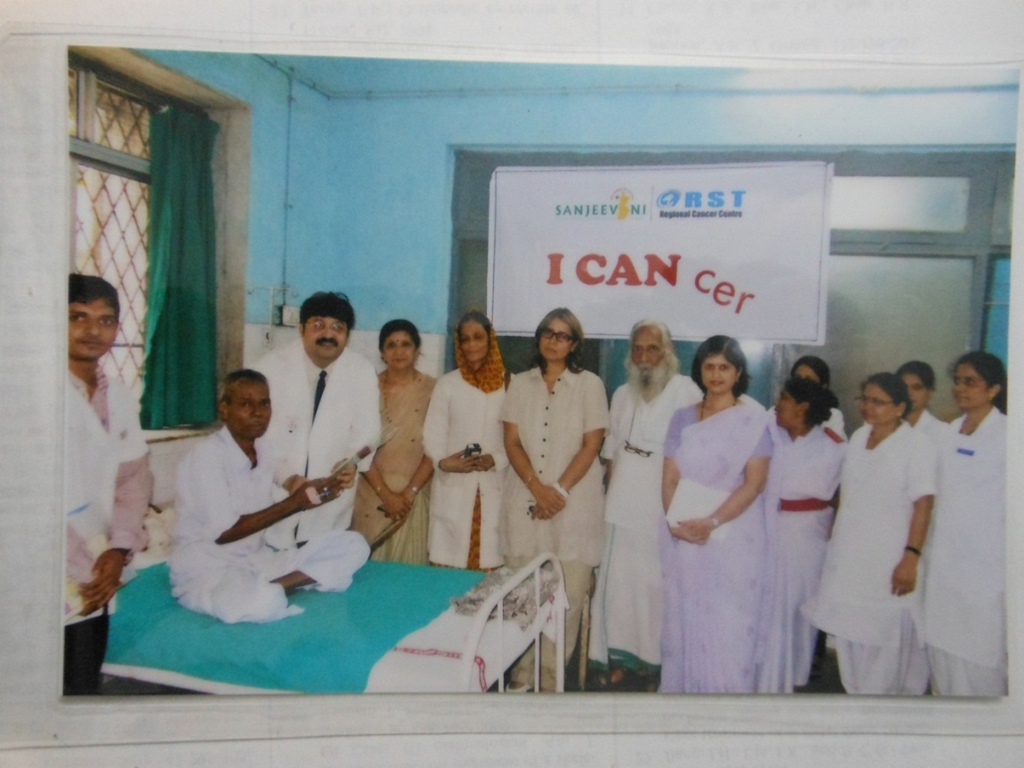
Celebrated Rose day with patient along with Director Dr. Chaudhari
REGIONAL CANCER HOSPITAL NAGPUR (MAHARASHTRA)

Slide 31
Two cases were operated at central Cancer Institute for Mandible Surgery.
One was 71 years old who was doing mantra chanting of 45th Shloka of Bhaktamar and other was given only surgery, he was 38 years old.
Results:
The patient who was chanting mantra was shifted from ICCU the very next day, did not require chemotherapy and was discharged within a week and his ryles tube also to be removed within four days of discharge .
“This is the power of Bhaktamar Stotra.”
Dr. Ajay Mehta ,Oncologist says he has recovered within 15 days, which would otherwise require three months.

Slide 32
Dr. Ajay Mehta ,Oncologist says he has recovered within 15 days, which would otherwise require three months.
“This is the power of Bhaktamar Stotra.”

Slide 33
Patient is reading 45 th shloka of BHAKTAMAR STOTRA

Slide 34
An 0ral cancer patient before surgery

Slide 35
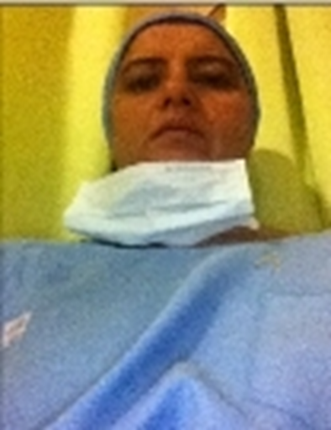
Chanting of Mantra during Mandible surgery
Dr. Ajay Mehta during surgery
Dr. Manju Jain Chanting Baktammar

Slide 36
Surgery successful

Slide 37
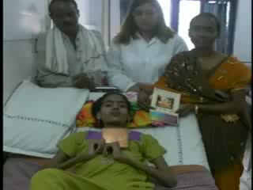

Slide 38
THANK YOU

