Slide 1
Mantra Healing
Bhaktamar Program Creator and Owner: Acharya Mantunga Maharaj

Slide 2
Mantra
The word ‘Mantra’ means ‘tool of the mind’ or ‘the language of human spirituality,‘) when repeated over a period of time, cause a ‘shift’ in your consciousness.
As a result of this, you attract different results in your life whether that‘s in terms of health, relationships or anything else.
Your life is going to improve in all respects.

Slide 3
Mission
To be a leading organization advocating the power of Bhaktamar Stotra
Bhaktamar is a very powerful tool of Jainism.
It has solutions to all problems faced by human beings.
If chanted methodically and with full belief.

Slide 4
Objectives
Spread the message of Bhaktamar Stotra
Bhaktamar awareness program - Bhaktamar Darshan
Build on momentum and promote the procedures and methodologies of Bhaktamar Vrat - ‘How to Do’ for every one.
48 Solutions for different problems.
Formulate Bhaktamar chanting program to reach the special needs, disadvantaged people and geographically remote areas.
In extra ordinary circumstances.

Slide 5
Program - Bhaktamar Stotra
Team
Seek partners and volunteers to help plan and execute the program.
Target Audience
Work to attract a diverse audience with special emphasis on special needs, disadvantaged people.
Program Modules
To create a dedicated program of events for group of people. (Special needs, stressed, depressed, etc.)
Enshrine transparency at the heart of the program.
Provide appropriate arrangement for outstation, abroad special needs access.
Event logistics guidelines to be formulated in template format example.

Slide 6
Program - Bhaktamar Stotra
Time needed | Define time
Equipment needed | 1 | Video Player,
 | 2 | Audio cassette players
 | 3 | Electrical extension cord
 | 4 | Low intensity table lamp
 | 5 | Microphones
 | 6 | P.A. system for larger crowd.
Event Hall (Size/Type) |  | Square/Rectangular
Water, Rest rooms, Generator, Power back up |  | Ensure availability of electricity for necessary equipment.
Timings |  | After the cutoff time, no entry to latecomers. Late comers to be given option of joining the next program.

Slide 7
Performance Measurements
Measure number of camps held for all.
Measure number of special needs people undertook the mantra chanting program.
Mantra chanting experiences of the people.
Case study 1 - Terminally ill cancer patient
Case study 2 - Oral cancer patient
Case study 3 - Prolonged case of psoriasis
Distant healing through mantra chanting.

Slide 8
Process of Spiritual Healing
Basics:-
Firm faith in God is a must.
Qualification for receiving the divine energy:
Right faith is having belief in pure and perfect soul.
Right knowledge is to know the real nature of soul.
Right knowledge should be free from doubt and indefiniteness.
Right knowledge is considered perfect when it does not suffer from any wrong belief, because wrong belief perverts both understanding and attitude.
Right knowledge reveals the nature of things exactly as they are with certainty.

Slide 9
Process of Spiritual Healing:
Although right faith and right knowledge occurs simultaneously as…
Lamp and Light
But Right Knowledge is the Effect
And Right Faith is the Cause.

Slide 10
Self healing acceptance
Affirmation for receptivity of mantra.
Invocation by healer
I am not the body, nor thought or emotion.
God you are the only one who can cure me.
Thinking that this body is only suffering and not the soul.
THE POWER OF CURE IS WITH YOU, OH! GOD

Slide 11
Spiritual healing to be more effective
Worship of Lord.
Worship of receptors.
Study of scriptures (Evidential stories)
Practice of self control.
Practice of simplicity and clarity.
Spiritual healer should restrain himself from following for better results.
Use of non vegetarian.
Use of alcoholic drinks.

Slide 12
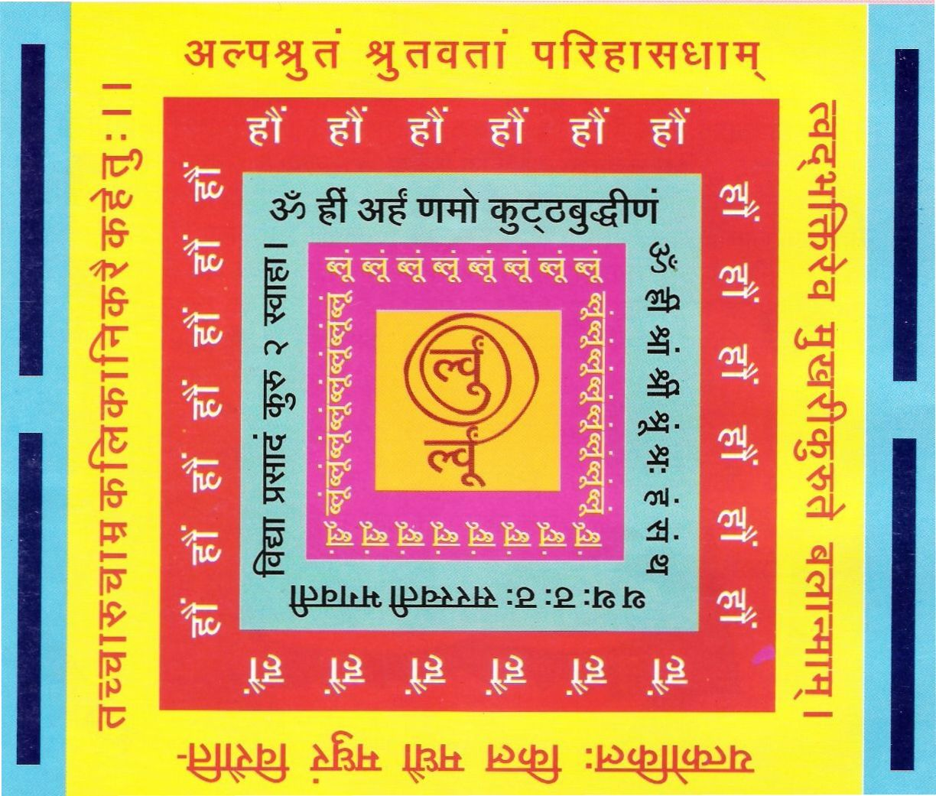
Om hrīm shrām shrim shrum shrah ham sam tha tha thah thah thah Saraswatī Bhagawatī Vidyā Prasādam Kuru Kuru Swahā
Mantra:
Alpashrutam shrutawatāmparihāsadhām
Tvadbhaktiréva mukharicuruté balānmam
Yatkokilah kila madhau madhuram virauti
Tachchāmrachāru kalika nikaraika hetuh
Viyuktavyakti - Samyojaka Yantra -6-

Slide 13
6th Shloka - Solution for increase the memory, capacity to learn, reunites the separated persons
Method
Having bathed and dressed in red, the yantra is placed and worshipped and seated on red seat the Riddhi and mantra syllables are chanted 1000 times a day for 21 days. Every time oblibanum is offered. A one time meal a day and sleeping on earth is followed.
Resources
Red clothes, Red Seat, Yantra, Mantra, Riddhi and Shlokas,
One time meal a day, sleep on earth.

Slide 14
Meaning of 6th Shloka
Oh Lord! I know my limitations and I cannot vie with highly knowledgeable people.
I have not even heard as much as them, my humble creation is just not to be compared with their great verses, prayers and poetry.
I would ask all of them:- “See, have I created all these prayers deliberately? No, not at all. My small heart is overflowing with the love of God; therefore some words and stanzas have fallen here and there from it!
What can I do for that?”
Just look at that cuckoo. Just ask her if she knew the rules of music. Just ask her whether she knew about the meters and Ragãs: Tala & Laya(Rhythm)?
She will reply that she is not singing in an orchestra. Nor she is willing to get auditioned for music.
Contd…

Slide 15
Meaning of 6th Shloka
The blossoming mango, full of fragrance, tempts me to sing. If you want to listen, do so; and if you like, you may also sing. You name it a poem or a pun as you like. Who cares?”
Similarly, Acharya Manatunga states that whether critics consider this Bhaktamara Stotra as a beautiful poem or a mere pun, he is indifferent.

Slide 16
Advantages of Chanting 6th Shloka
The person separated also reunites.
Remembering the sixth verse and Riddhi Mantras
syllables everyday and keeping Yantra near you increase
the memory, capacity to learn very soon.
6th shloka activates latent talent and abilities.
Hypothesis chanting of “6th Shloka” gives effects:
Changes the pattern of intelligence.
Changes the aspirant for good behavior.
Improves memory retention capacity of students.
Enhances the of concentration in students.

Slide 17
6th Shloka - Solution for increase the memory, capacity to
learn, reunites the separated persons
Preliminary studies conducted in Mordern school Jingle Bells.
410 students between age group 2.5 to 5 years for a period of
one month
Findings:- I.Q. and memory enhancement
Improvement in concentration.
Improvement in grasping power.
Improvement in behavior at home.
Class work and Home work completion on time.
Clarity in pronunciation.

Slide 18
Manju Jain

