Slide 1
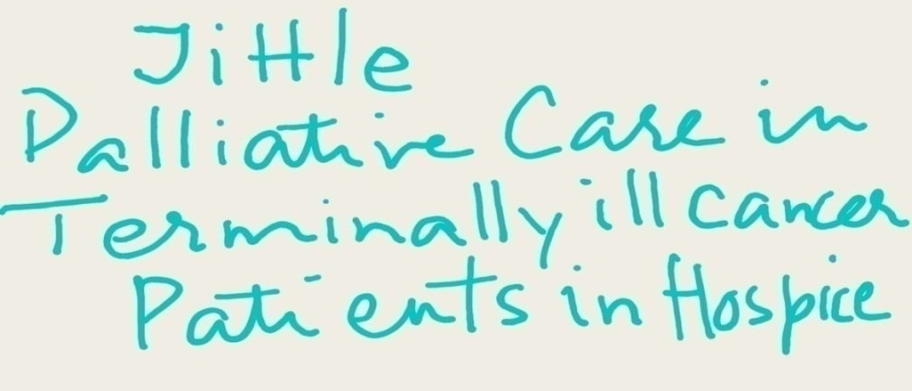
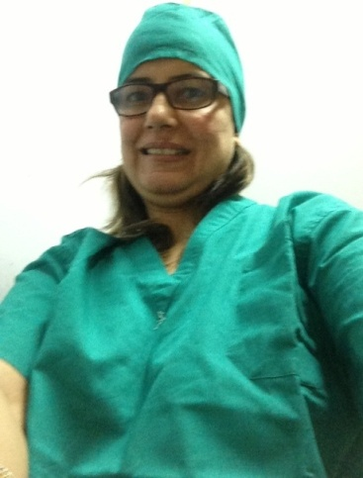

Inspired by
Dr. Anne Merriman
Dr. Manju Jain
In field of Hospice & Palliative Care we honor
Dr. Anne Merriman, Founder & Director, International Programmer, Hospice Africa, Uganda,
nominated for Nobel Peace Prize

Slide 2
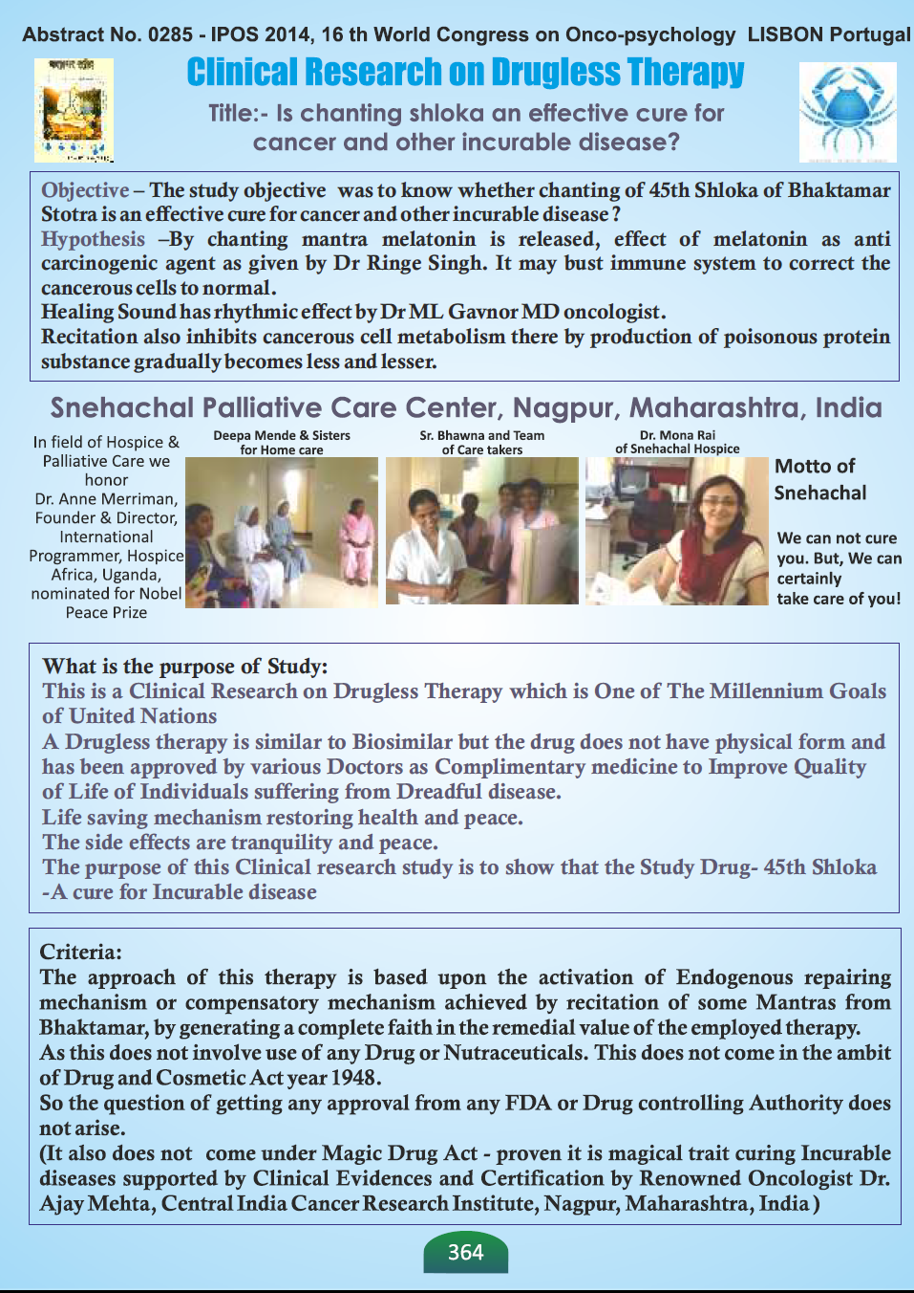
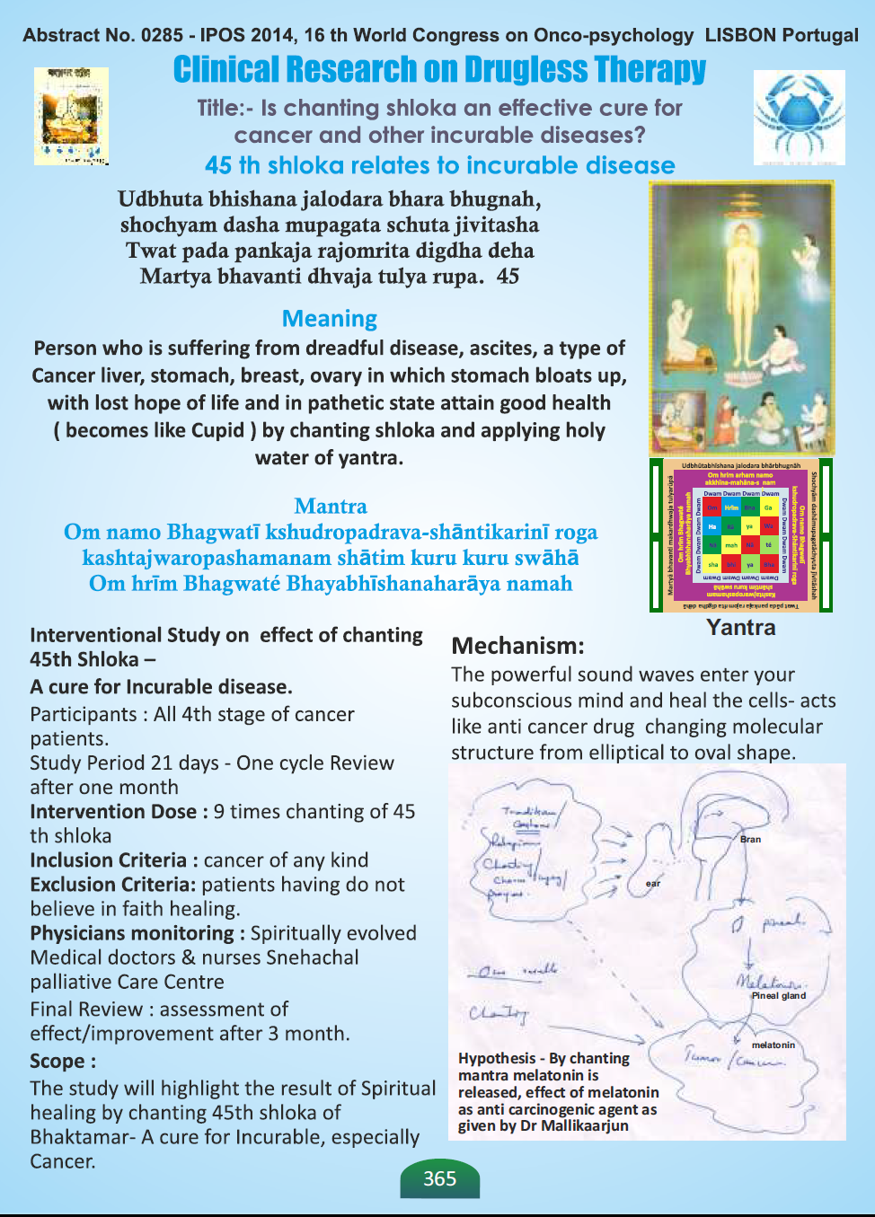

Slide 3
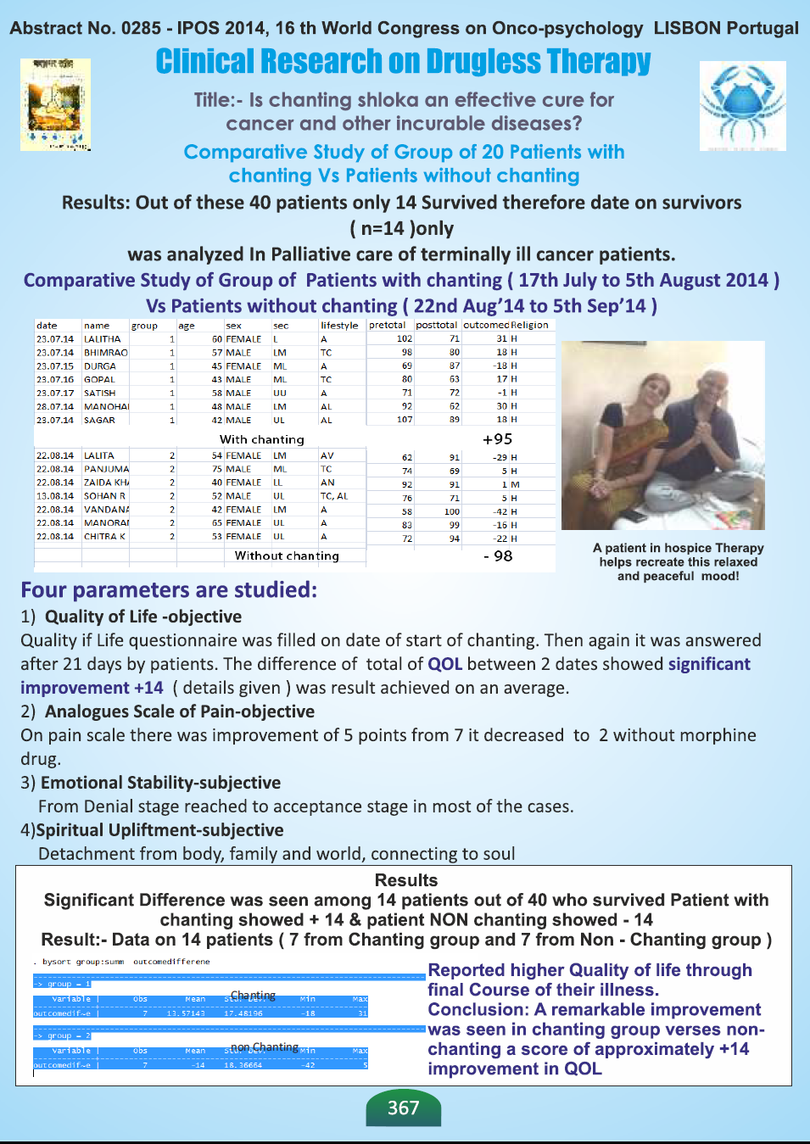
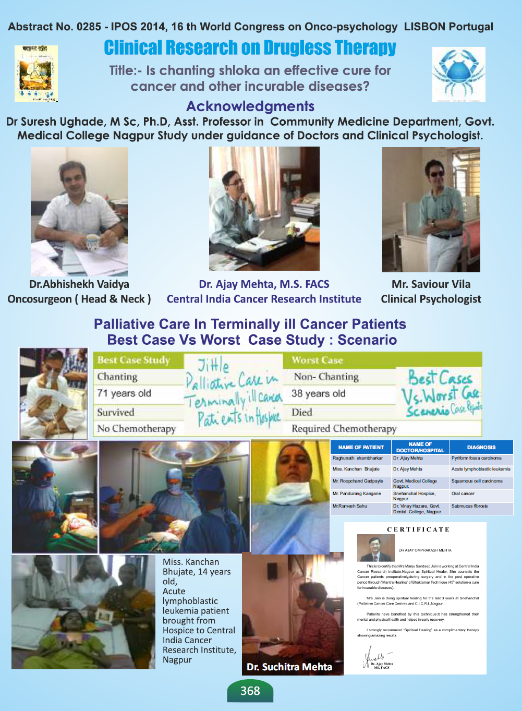

Slide 5
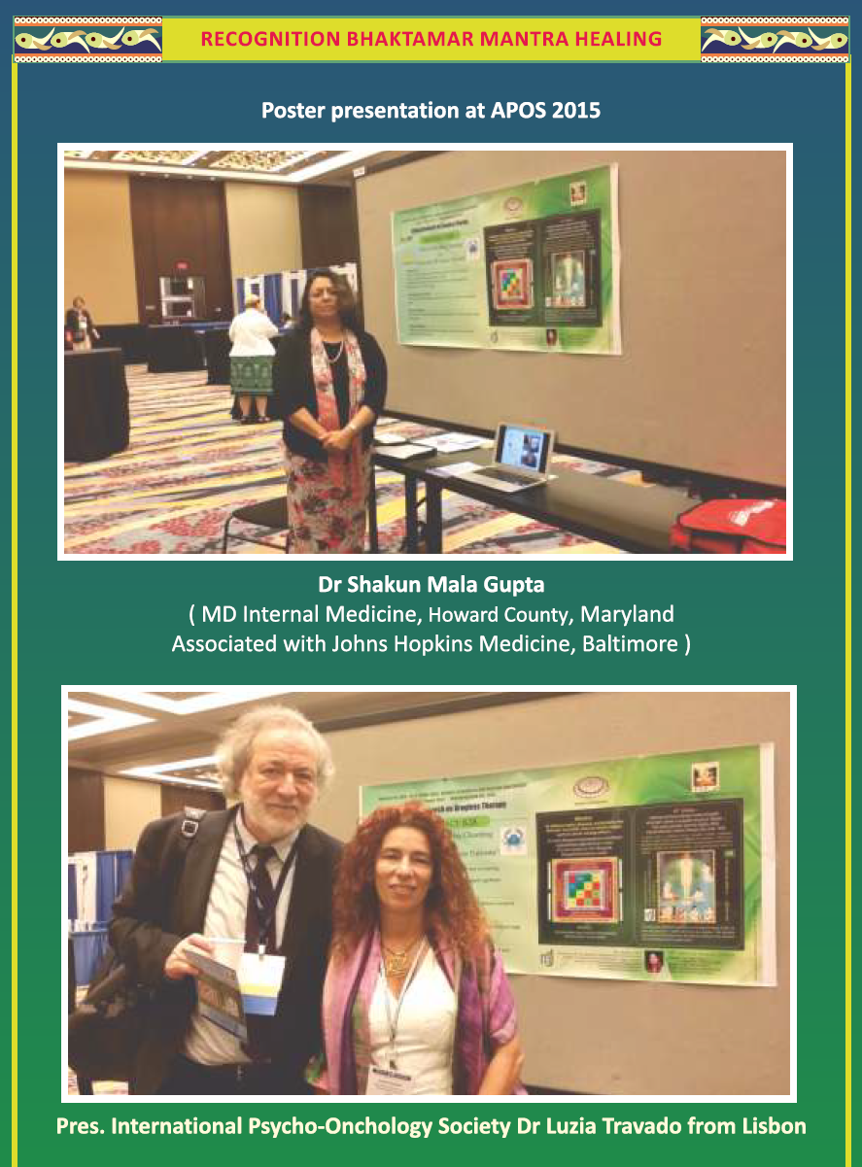
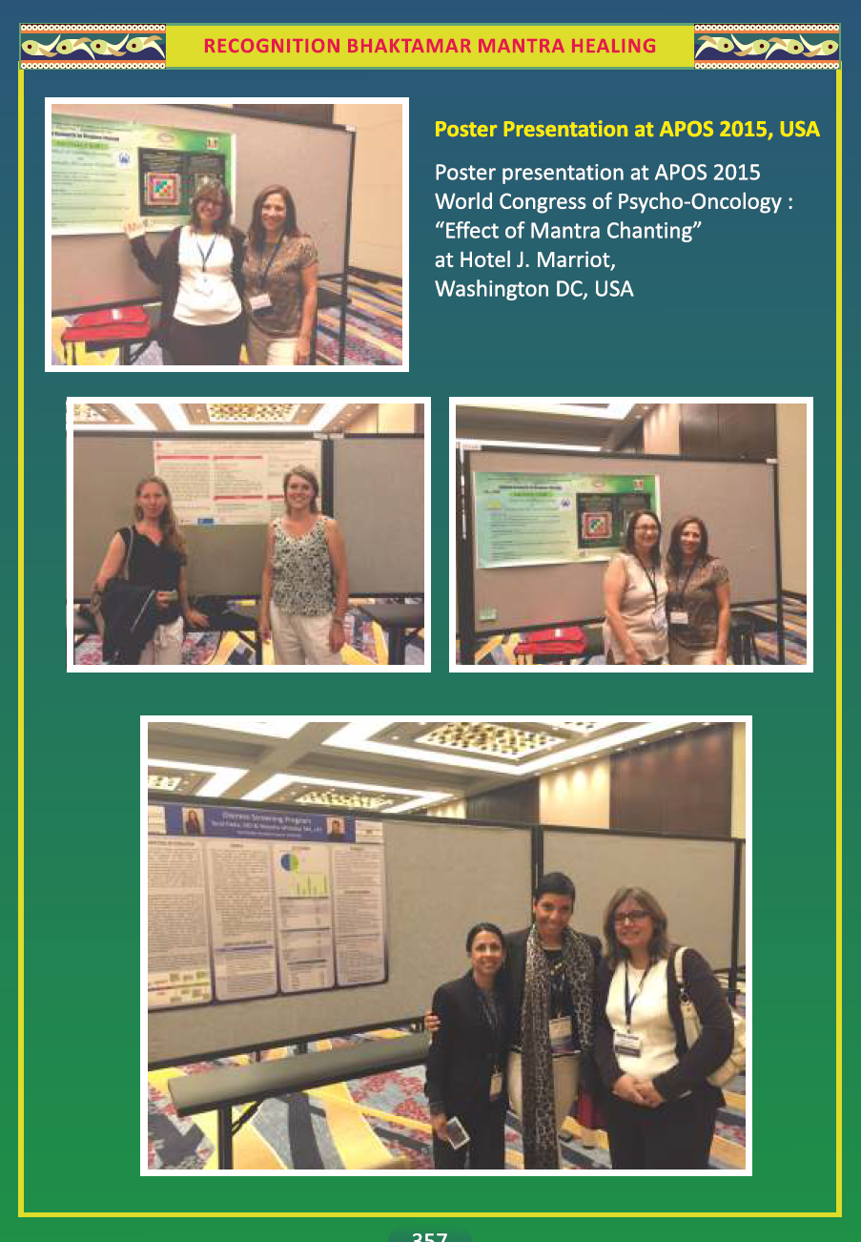

Slide 6
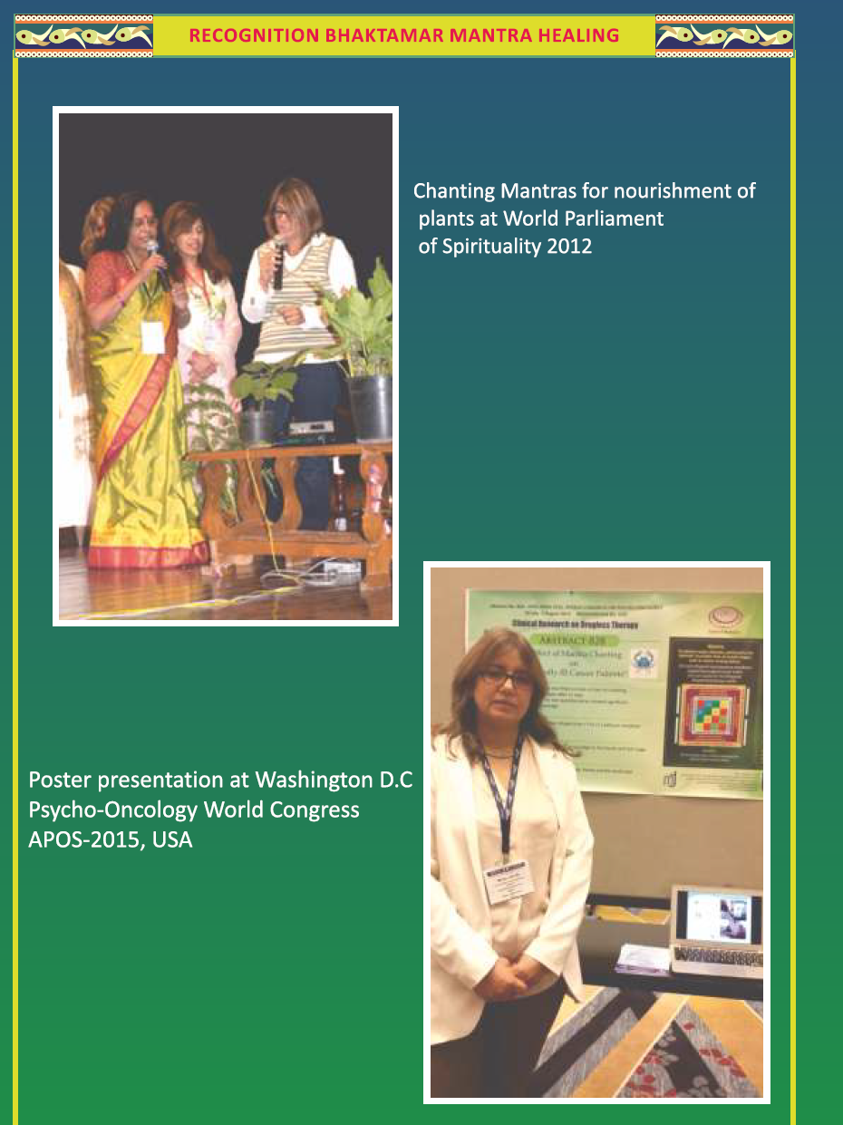

Slide 7
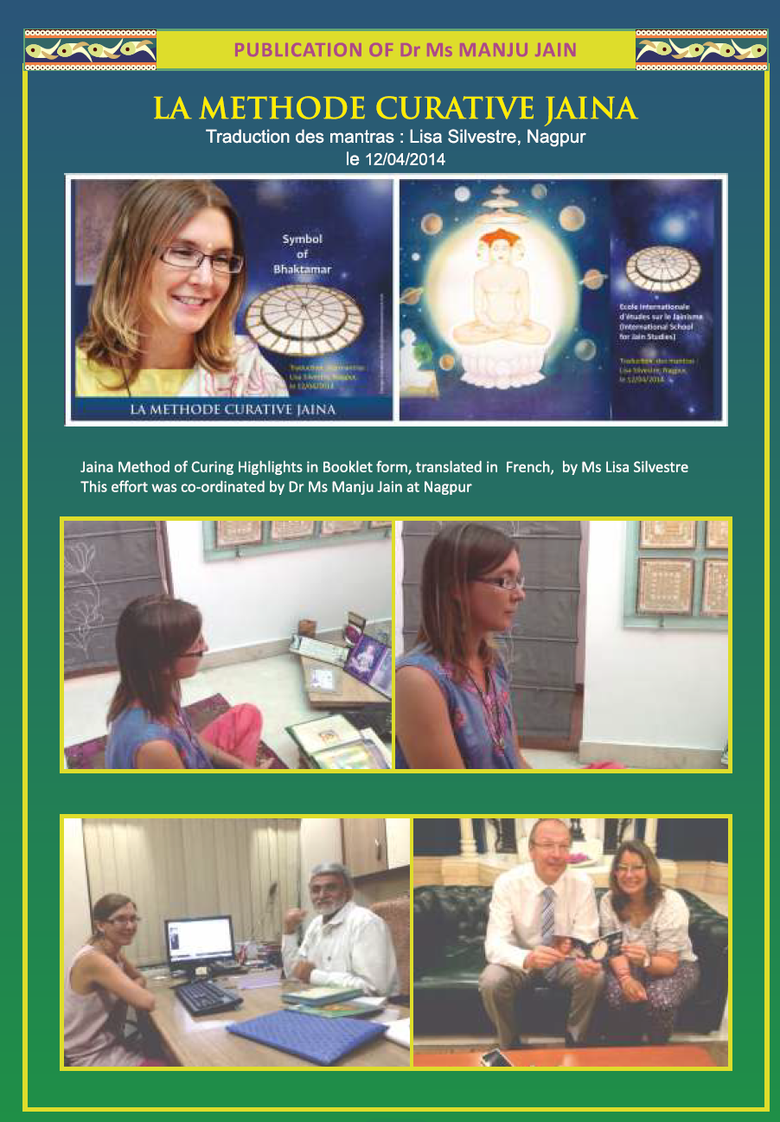
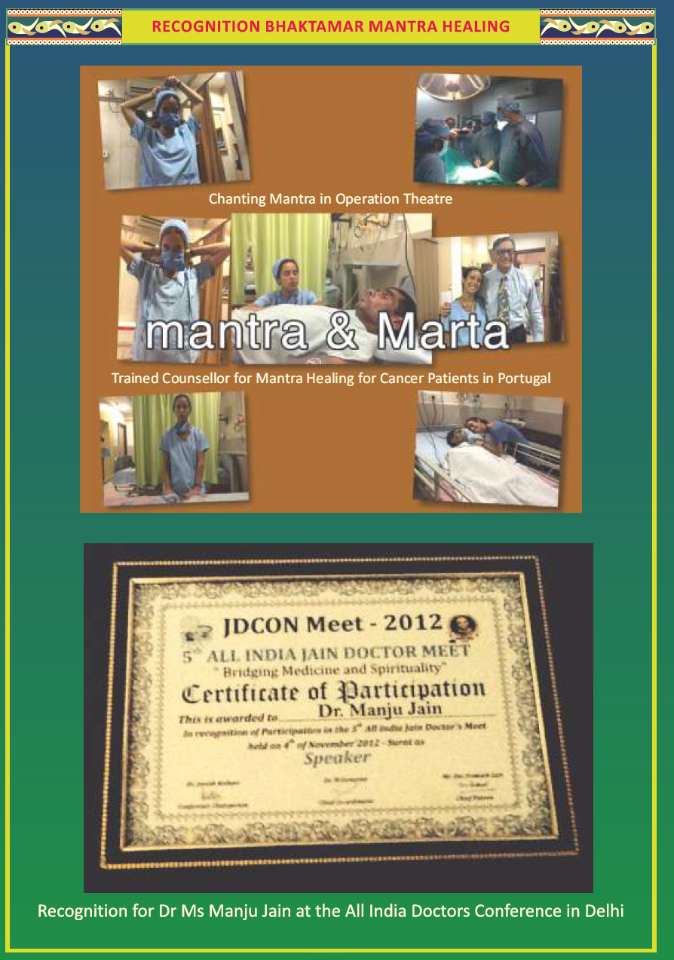

Slide 8
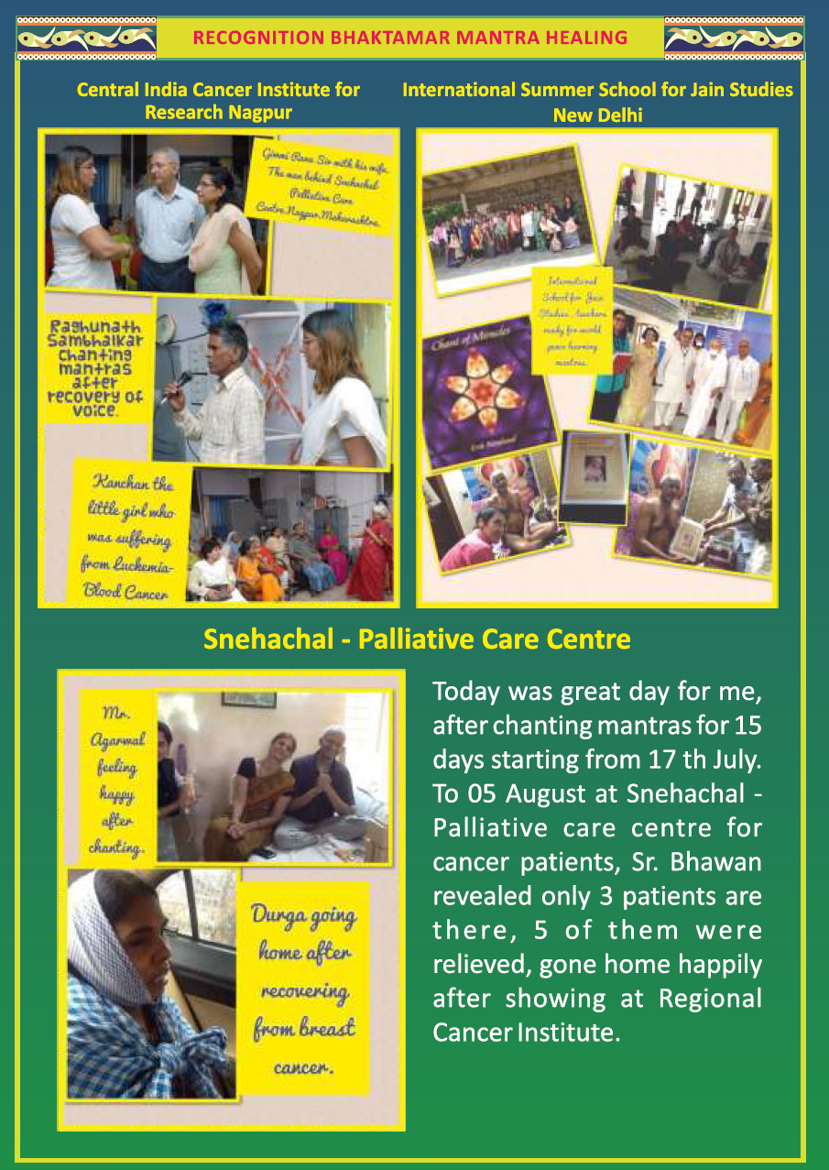
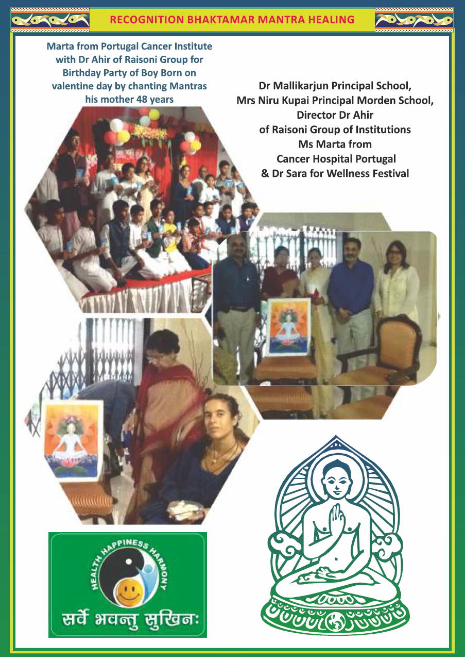

Slide 9
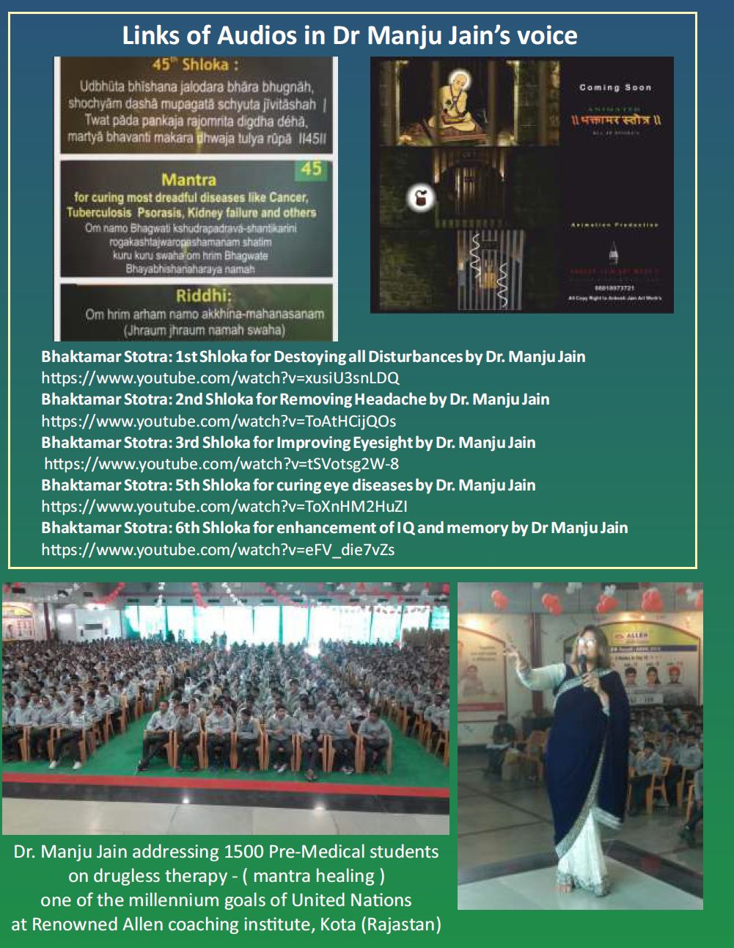
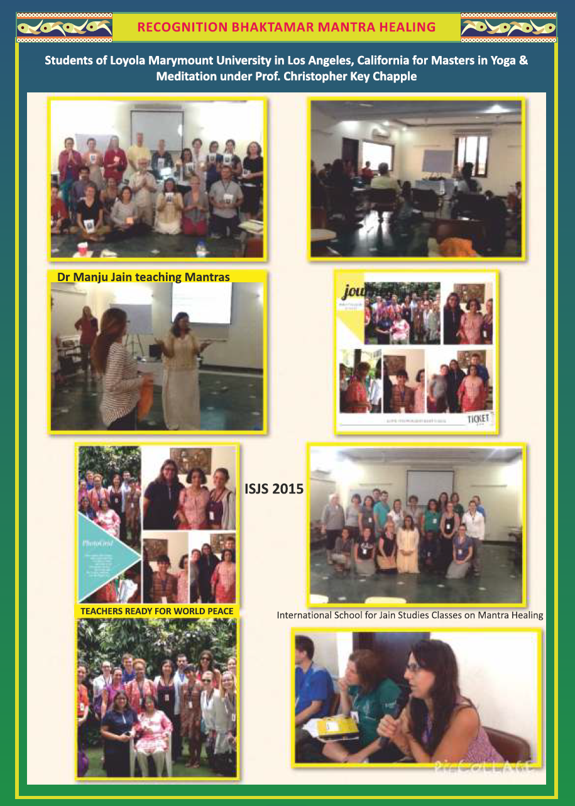

Slide 10
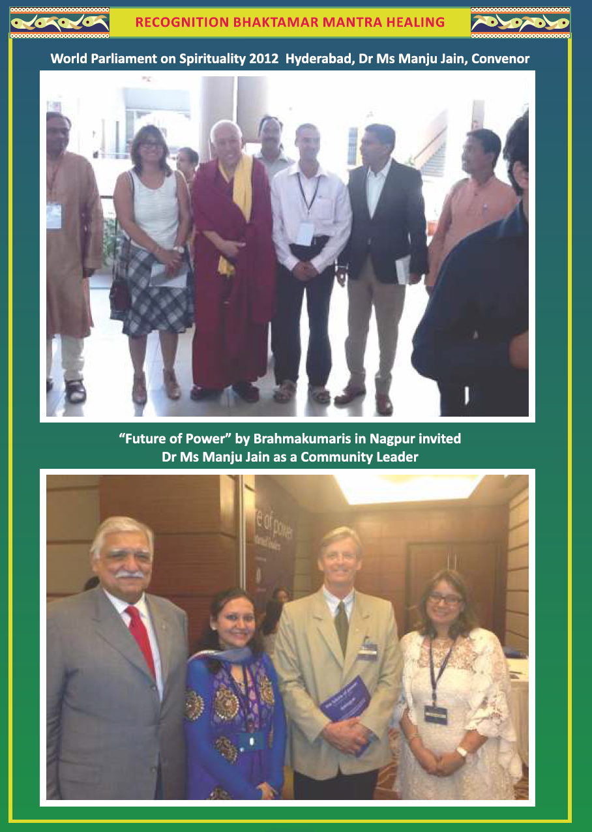
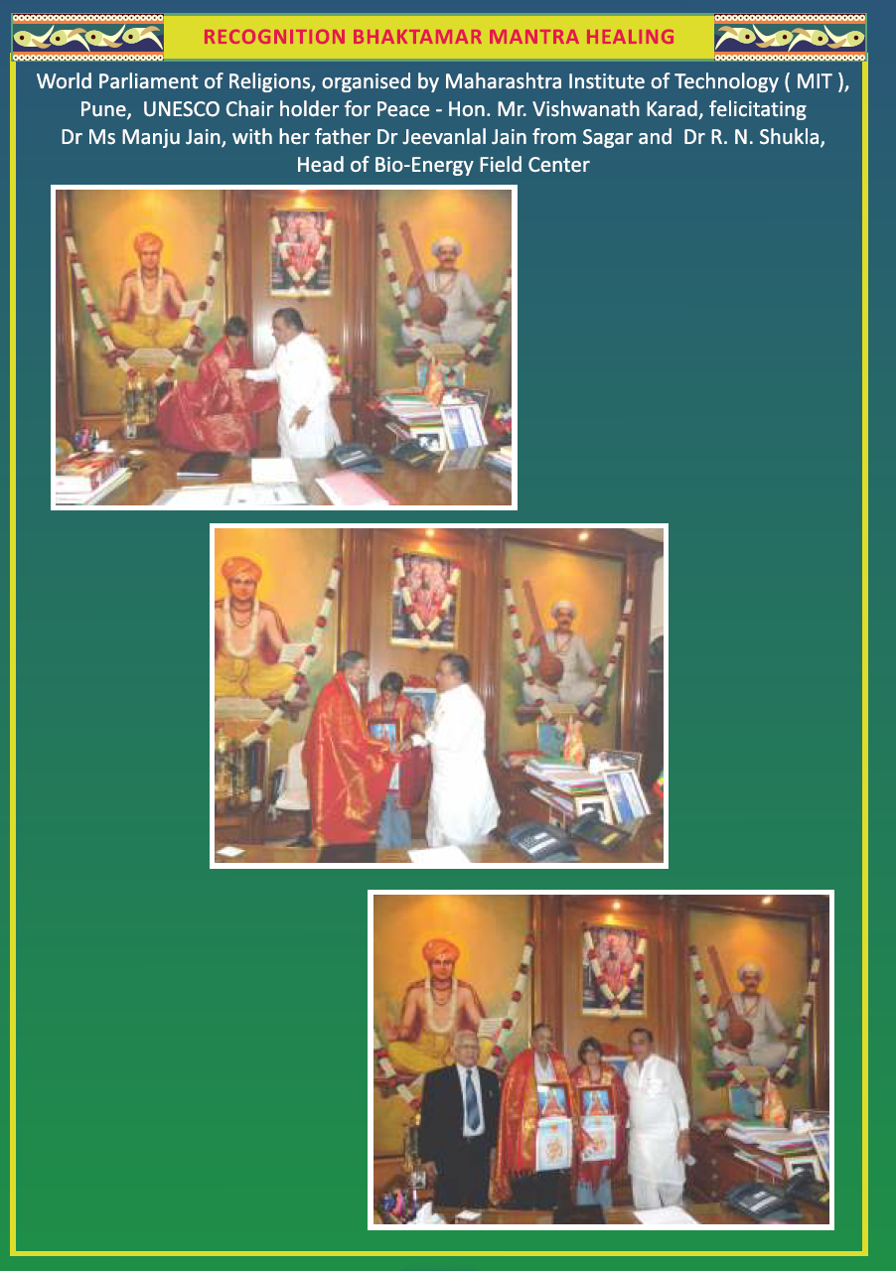

Slide 11
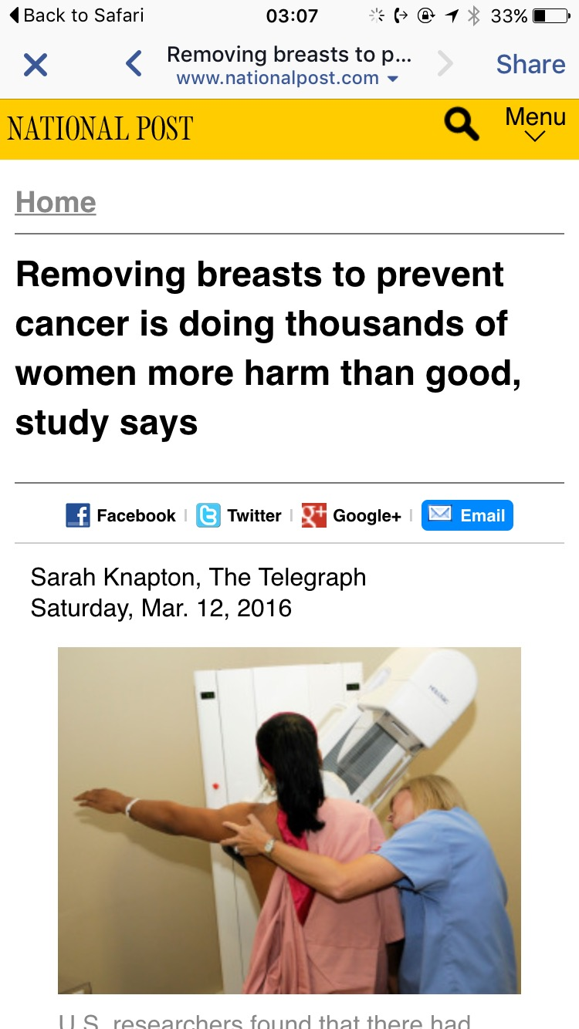
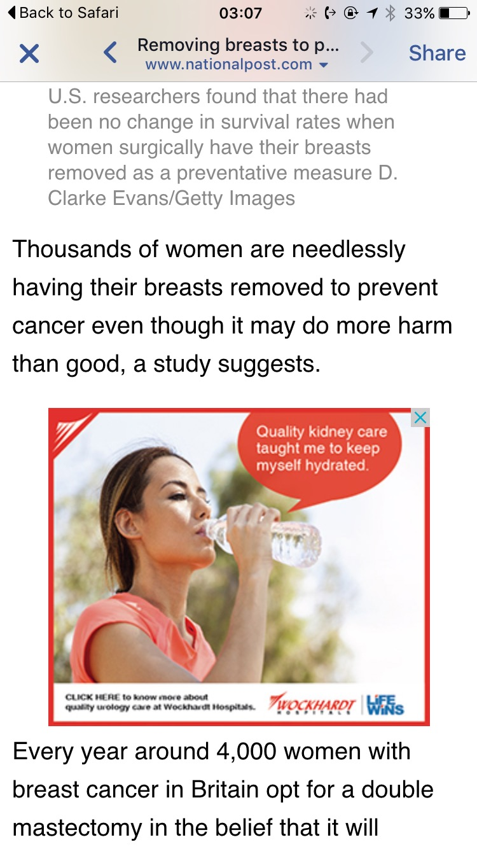

Slide 12
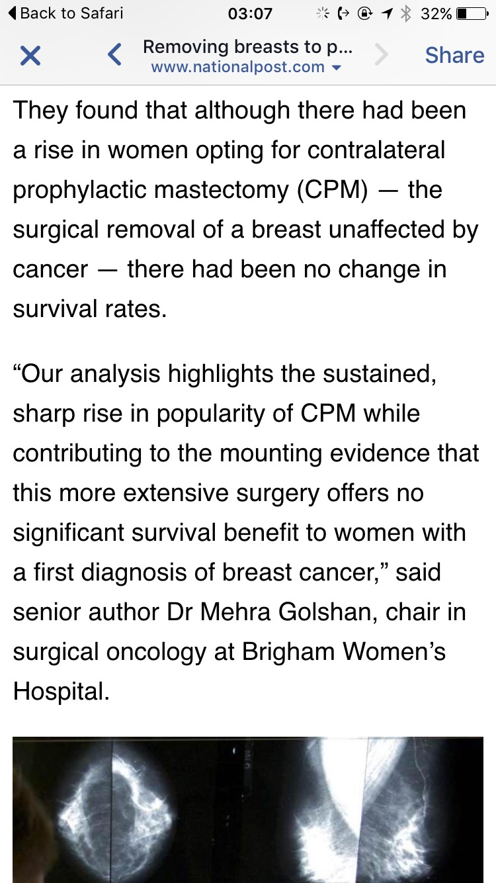
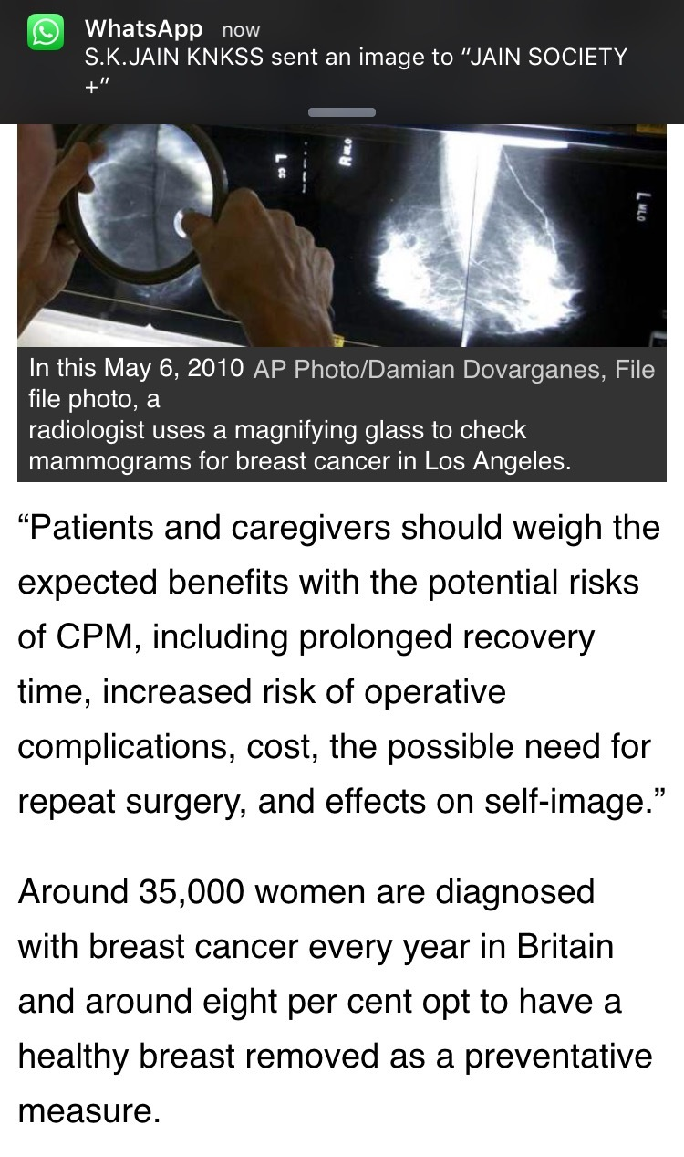

Slide 13
WHO Strategy 2014-2023 - A Traditional Medicine and Complementary Medicine
Clinical Research on Drugless Therapy which is One of The Millennium Goals of United Nations
Bhaktamar - A Drugless therapy is similar to Biosimilar but the drug does not have physical form and has been approved by various Doctors as Complementary medicine to….
Improve Quality of Life of Individuals suffering from Dreadful disease.
Life saving mechanism restoring health and peace.
The side effects are tranquility and peace.

Slide 14
Criteria:
The approach of this therapy is based upon the activation of Endogenous repairing mechanism or compensatory mechanism achieved by recitation of some Mantras from Bhaktamar, by generating a complete faith in the remedial value of the employed therapy.
As this does not involve use of any Drug. This does not come in the ambit of Drug and Cosmetic Act year 1948. So the question of getting any approval from any FDA or Drug controlling Authority does not arise.
It also does not come under Magic Drug Act- proven it is magical trait curing Incurable diseases supported by Clinical Evidences and Certification by Renowned Oncologist Dr.Ajay Mehta , Central India Cancer Research Institute, Nagpur, Maharashtra, India.

Slide 15
Objective
To determine the efficiency of Mantra & Meditation Chanting Program in improving stress related outcomes (anxiety, depression, stress/distress/mental health)
By Mantra Chanting and creative visualization – fear changes to positive mood related to quality of life.

Slide 16
Mission
To be a leading organization advocating the power of Bhaktamar Stotra
  Bhaktamar is a very powerful healing tool.
  It is faith based healing.
  If chanted methodically and with full belief.

Slide 17
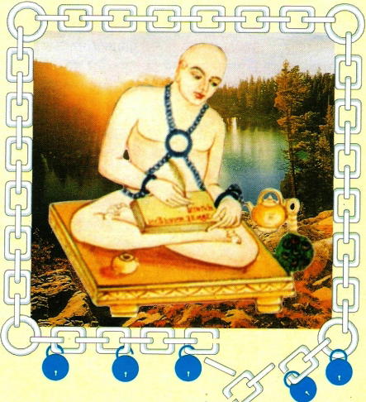
Bhaktamar Stotra is composed by Acharaya Mantungaji has a very high place of pride in Jain holy literature.
Devotee Mantungacharaya while reciting the attributes of the vulnerable detached Lord Adinath in this devotional poetic Stotra expressed the desire to become like him.
This information is not intended nor it should be interpreted as preaching religion.
You should see the meaning of BHAKTAMAR
BHAKT = DEVOTEE, AMAR = IMMORTAL.
All Human being becomes immortal by chanting shlokas with full devotion
Acharya Mantungaji

Slide 18
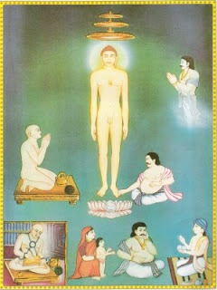
45 ^{th} shloka relates to incurable disease
Udbhuta bhishana jalodara bhara bhugnah,
shochyam dasha mupagatas chuta jivitasha
Twat pada pankaja rajomrita digdha deha
Martya bhavanti makardhvaja tulya rupa 45
Meaning
Person who is suffering from dreadful disease, ascites, a type of liver cancer in which stomach bloats up, with lost hope of life and in pathetic state attain good health (becomes like Cupid) by chanting shloka and applying holy water of yantra.

Slide 19
SOUND THERAPY
SCIENTIFIC ANALYSIS OF MANTRA
Music or sound therapy
Tranquility state
Everything has particular vibratory frequency, every thought every word and every emotion.
Realizing this fact ,that SOUND is the most powerful element .
Our ancient sages developed the science of MUSIC or SOUND Therapy, called bio waves or mantra collection of MANTRA is called STOTRA.

Slide 20
AT PHYSICAL LEVEL
Sound works with movement of tongue.
Hard palate forms 84 meridian points
Pronouncing MANTRA stimulates these meridian points which stimulates HYPOTHALAMUS to secrete neurotransmission fluids
Sound vibrations also received by the ear

Slide 21
Sound Vibration
Ear
Electric signal
Frontal Lobe
Acoustic Bar
Acoustic Nerve
Lift his Spirit up
Bring Back beautiful movement
Make him deliriously happy
Sensation of energy flow head from base
Various parts of Body

Slide 22
Study of effect of chanting 45th Shloka - A Preventive Medicine for Incurable disease.
Participants : All 4 stages cancer patients.
Period 21 days - One cycle Review after one month.
Dose : 9 times chanting of 45 th shloka
Inclusive Criteria : cancer of any kind
Exclusive Criteria: patients having no faith in the system.
Physicians monitoring : Spiritually evolved beings
Final Review : after 3 months
Scope :
The study will highlight the result of Spiritual healing by chanting 45th shloka of Bhaktamar- A preventive medicine for Breast Cancer.
Mechanism:
The powerful sound waves enter your subconscious mind and heal the cells- acts like anti cancer drug changing molecular structure from elliptical to oval shape.

Slide 23
A Systematic Review & Meta Analysis
Many people chant Mantras to reduce psychological stress and fear related to recurrence of cancer. (Shri Aurobindo says – Mantra is highest – Absolute form of speech – Pure & Powerful).
To counsel people appropriately, clinicians need to know what the evidence say about the health benefits of chanting mantras.

Slide 24

Faith based Healing
Class I 75%
Class II 25%
44
A Systematic Review & Meta Analysis
75% had moderate healing & Positivity.
25% had very low healing & Positivity.
What may increase the Faith based healing in breast cancer patients?
Seeking reassurance too often. Your perception of Self healing methods.
See YouTube videos of cancer patients like Anita Moorjani who could dissolve her
lemen size tumor & spiritual healing videos of testimonials of patients chanting
mantras.

Slide 25
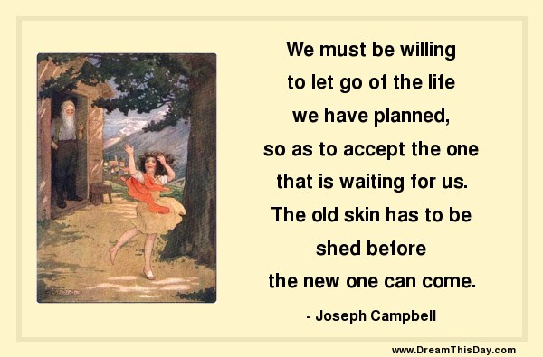
We are delighted to inform you that your research paper " Mantra chanting and effective Preventive Medicine touching 6 th element spirituality as per USA public health " has been " Accepted for Publication " in International Journal of Engineering Trends & Technology (IJETT), October 2016, ISSN: 2231-5381.

Slide 26
While doing research on effect of chanting Mantras in Breast Cancer patients with chemotherapy, some additional important findings were seen on side effect of chemotherapy.
Lymph node removal leads to hands becoming like a log and movement of hand was disabled in most of the cases.
In few cases the ladies started walking with the help of walker, lost her ability to walk due to side effects of chemo as endorsed by Oncologist.
Mrs. Pugalia had to get her water retention in breast removed by suction every week after chemotherapy. The accumulated fluid in breast was to be suctioned every week.

Slide 27
Some of the cases which recovered in breast cancer while chanting mantra without chemotherapy:
A lady from Pune could bring down her CA 125 from 16 to 12 within 21 days of chanting.
Another lady within a span of 3 months of chanting could bring down her CA 125 from 1900 to 60 within 3 months of chanting without chemotherapy.
Anxiety and fear level of ladies was brought down from 15 to 10 and Fear of Recurrence Scale.
In few cases the T Helper cells increased by chanting as is proven in Yoga and Meditation also.
Overall study we can presume that the circulating tumor cells reduced from 10 to 2 as per Doctors, but we need to reasure with equipment which above our budget and not available in Nagpur.

Slide 28
Testimonials:
Today Mrs. Charu Jain. who has 8 years of history of Ovarian cancer which has spread in stomach, omentum and side walls of intestine is living happily with her colostomy bag removed within period of 6 months from surgery by Dr. Harith at Max Hospital.
Dr. Geeta, a Cancer Specialist in Gynecology says Allopathy is only 200-400 years old medicine and Ayurveda is 5000 years old science and speaks of health wellness (Positive Health ) The Logo say “Om Sarve Bhawantu Sukhinah, Sarve Santu niramaya” (Be happy, be healthy see the good ) where as Allopathy says “Disease is certain and Health is an accident”

Slide 29
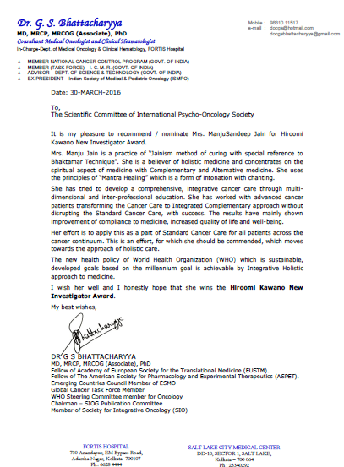
I am Shiksha Jain from Kolkata and I have been suffering from colon cancer since October 2012. After getting treated and healed I was again hit by ovarian cancer in the year 2014. During my second chemotherapy for ovarian cancer I was infected in my stomach which lead to me using a colostomy bag. Doctors were slowly giving up on me and the only source of my will was my parents, who were continuously praying for me and this is when my mom induced in me the powerful chants of BHAKTAMAR. During my painful treatment I inculcated the habit of listening to BHAKTAMAR on a regular basis. The divine 48 shlokas of BHAKTAMAR has miraculous powers of curing the incurable diseases. Some people recover because they believe in doctors and some do because they have faith in God. Slowly there were positive changes in my life and all the negativities of the harsh treatment were washing away. This is when my parents told me about the significance of the all powerful 45th shloka in healing diseases.

Slide 30
To know the inner meanings of the 45th Shloka I started to Google and gather all the knowledge I could get of this Shloka. It was then I found out about Dr. Manju Jain who has a PhD. in BHAKTAMAR. Reading about her life and how she helped in recovering people worldwide from incurable diseases gave me an uncontrollable urge to meet her as soon as possible. How only chanting and belief in the powers of the mantra could heal someone was astonishing to imagine. After meeting her and spending a good few days with her I was shocked to see the changes that had taken place in my life. Not just physically but those shloka were healing me mentally. Later after a few days of having cough and cold I was asked to get a CT scan done in which the doctors found nodules in my lungs. I had again undergone a few tests for tuberculosis. During this period of 10 days I started putting more emphasis on the 45th shloka in particular and the entire BHAKTAMAR in general. After 10 days my reports were out and no signs of tuberculosis were found and the nodule had resolved. Everybody was surprised to see my results and I was extremely happy. So this is how BHAKTMAR has brought a positive change in my life and I m sure it will also help each and every person who chant these shloka with utter faith and belief. Not only the BHAKTAMAR but any spiritual chant should be chanted with 100% belief and faith in the almighty.

Slide 31
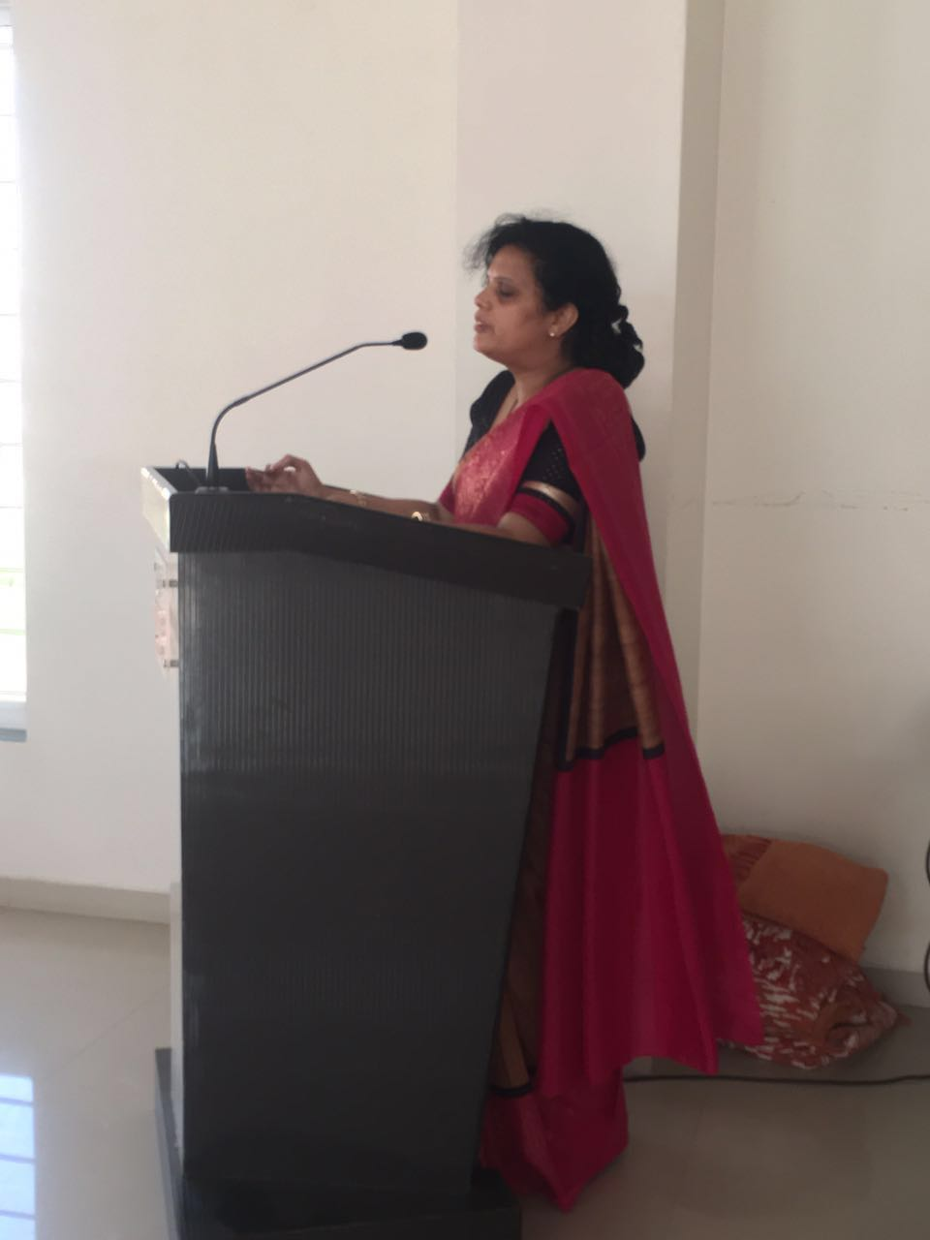
Sujataji from Pune had been diagnosed ovarian cancaer and got to know about Mantra Chanting. She came to Mumbai, while driving from Pune and started chanting for herself as well as for others when her CA 125 came down from 16 to 12. Today cancer is free as endorsed by Doctors and she has healed around 25 patients which who got better sleep, their anxiety was reduced and their pain was almost vanished and their pain was almost vanished.
While chanting for others Sujata Jain forgot about her disease and so much got engrossed in chanting and helping other group of cancer patients. Now she is preparing other lady from Mumbai suffering from Breast Cancer to become cancer free and work with her as a Healing Support Group on Drugless Therapy

Slide 32
A male patient from Nagpur who had cancer in large intestine was operated in my guidance – chanting mantras as throughout. Surgery done by Dr. Ajay Mehta . He is surviving from last 6 years happily and doing Abhisheka of Yantra, the Mystic Energy Symbol of 45th Mantra of daily for last 6 years and circulating the healing holy water to all patients and normal people as preventive medicine.
Success story of Mr. J.P. Jain can view on You Tube Channel.

Slide 33
Sharing her story of becoming disease free.
Chanting of Shloka

Slide 34
How common Faith based healing is depends on the type of patient.
75% had moderate healing & Positivity in women
breast cancer
25% had very low healing & Positivity
Hearing about another person’s Cancer recovery through
mantra chanting helps cancer survivor strong and
healthy.

Slide 35
Root cause of Disease is Fear of Disease
How much effort you spend in eradicating the fear of disease.
High effort & Low Stress.
Your effort to cope appears to work for you.
Keep up your efforts – Be positive.
Sign that your strategies are more effective bringing message of WELL BEING to Body.
If copying on your own is difficult consult a counselor on positive thinking & creative visualization. Dr. Sara whose book on Power of Subconscious Mind is the bestselling Author or Jaina Method of Curing by Chanting Mantras by Dr. Manju Jain.
How to cope strategies for keeping Healthy.
Deep breathing exercise by Dr. Anita Agarkar (Ph. D. in I.Q. & memory Enhancement Tool of Bhaktamar)
Mindfulness Meditation of Acharya Mahapragya Author of Harmonious Living published by H Parker.
Yoga – Preksha Dhyaan & Sukshona Dhyaan by LADNU University Professional.

Slide 36
What is recurrence?
A recurrence is a return or relapse of your cancer in the original location or somewhere else in the body.
What does recurrence happen?
The goal of drugless therapy is to remove cancer cells through Mantra chanting or creative visualization, Power of subconscious mind is 9 times higher than conscious mind.
Unfortunately, we can not kill all the cells through radiation and chemotherapy and some cells may be left behind and resurface later as a recurrence or metastasis.
What can I do to reduce the rest of recurrence?
Aware of self healing techniques
Be positive & practice creative visualization on healing.
Chanting mantras protecting aura from negativity.
Throw away fear out of the body, mind and soul like unwanted guest and
sleep properly.
Coping with fear of recurrence.
Explore deep breathing techniques
Meditation and Mantra Chanting
Listening to audios of 45th, 6th & 48th Shloka of Bhaktamar Stotra.

Slide 37
Tools you can use
Challenge your thoughts about managing cure by drugless therapy.
Learn about Self Healing Technique's.
Rely on Science of Quantum Physics.
Theory of Emotto Scientist on effect of words on molecular structure of water
changing the crystalline structure into beautiful hexagon shaped diamond.
How can I seek help?
Supportive Integrated healing Program Individual Services
Reiki
Pranic Healing
Group Support
Buddhist Chanting Groups
Supportive network of Bhaktamar groups city wise and country wise on WhatsApp

Slide 38
Tools you can use
It’s time for follow up health care appointments, scans, blood tests and other test reports. Hear and Read positive results of healing by chanting mantras and meditation.
Talk to your friends and loved ones about the self healing techniques and self examination.
Find a Bhaktamar Support Group
www.drmanjujain.com
www.bhaktamarhealing.com
www.integratedhealingforum.org
List of the name of equipment needed for finding…
a. circulating tumor cells count RTPCR Technique
b. For detecting immune logic response – Tcells
c. Pre-counseling and after counseling
d. Effect of Mantra chanting on tumor
e. How much tumor cells reduced from 10 to 2 CTC
Chant together/forceful element

Slide 39
Conclusion
We have talked about treatment of cancer by Mantra Chanting, meditation and creative visualization and positive thinking.
However it must be realized that complete treatment of cancer is not possible by single modality, multi disciplinary approach gives the best chances to the patient.
As per Dr. Ringe, Mantra chanting stimulates the pineal gland to secrete Melatonin which is anticarcinogemic and reduces the size of tumor.
According to Dr. Malikarjun, Circadian Rhythm plays an important role in Mantra Chanting. The same dose of Melatonin injected in rats in morning, afternoon, evening & night, showed that WBC count the fighter cells – soldiers increased in the morning & evening as compared to afternoon and in night it gave very good sleep while listening to the audios of mantra of 6th, 45th & 48th Shloka of Bhaktamar in voice of Estha Divine, Erik Berglund and Dr. Manju Jain and
finally CURE sometimes, HELP often and COMFORT always.

Slide 40
Introspection
Why you are interested in attending this mantra chanting session?
To spread the power of Bhaktamar 45th Shloka – “A cure for Incurable disease” as stated in Ancient scriptures (Jain by Acharya Mantungaji Maharaj approx. 3000 years ago.) It is a drugless therapy; cost free and side benefit is spiritual upliftment.
How you will use this new knowledge?
It helps in reducing fear of disease recurrence.
It helps in reducing psychological stress.
To counsel clinicians appropriately.
Show health benefits attained by chanting.
Mantra chanting program improving quality of life, reducing anxiety,
depression of patients.

Slide 41
Community Outreach
Plan to develop your own Country’s training programs in psycho-oncology:
We are working to develop chapters all over India through training at our established centre (Integrated Healing Forum). We intend to expand our train the trainee program throughout the country – state by state.
Management Effectiveness:
We intend to train patients, Palliative care takers, Nurses and Doctors.
Also we intend to teach children - School age and tertiary level on this technology
For self empowerment tools so that they can help themselves and others

Slide 42
Literature Review
Mantra and their relevance in Holy Scriptures (The spirit behind Mantras) BIBLE says – In the beginning there was word (Mantra) and word was God.
In genesis, also it is given that God said “Let there be light & there was light.” Sound came before light.
According to Brahma, Mantra is the Navel of Divine.
Muslim Swastika is worn by BOHRI Community of Muslim in which Quran Mantras are stated and they are protected by 4 angles representing the four directions.
“MANTRAS IS THAT WHICH PROTECTS US OR HELP US TO CROSS THE WORLD.”
JESUS CHRIST has spoken of Faith Healing. He healed 23 persons as stated in John & Mathews Bible and always asked them before healing. Do you think I can do this for you? And after healing he would say it is your faith in me which has healed you.

Slide 43
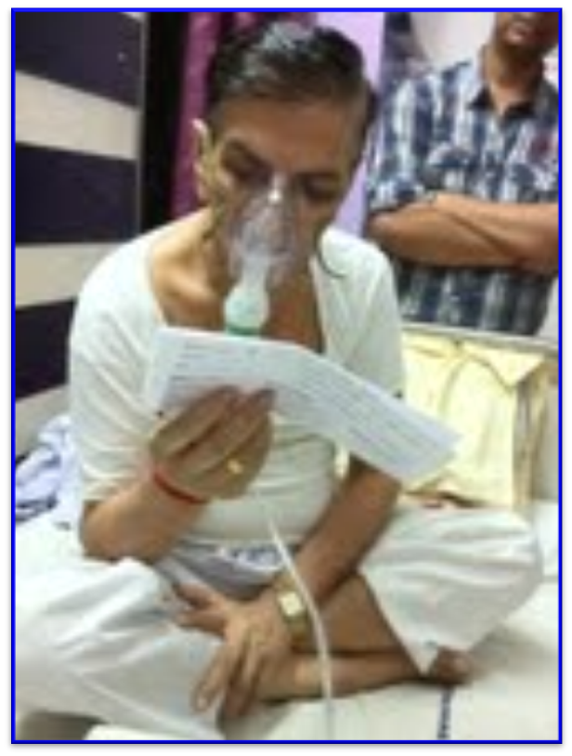
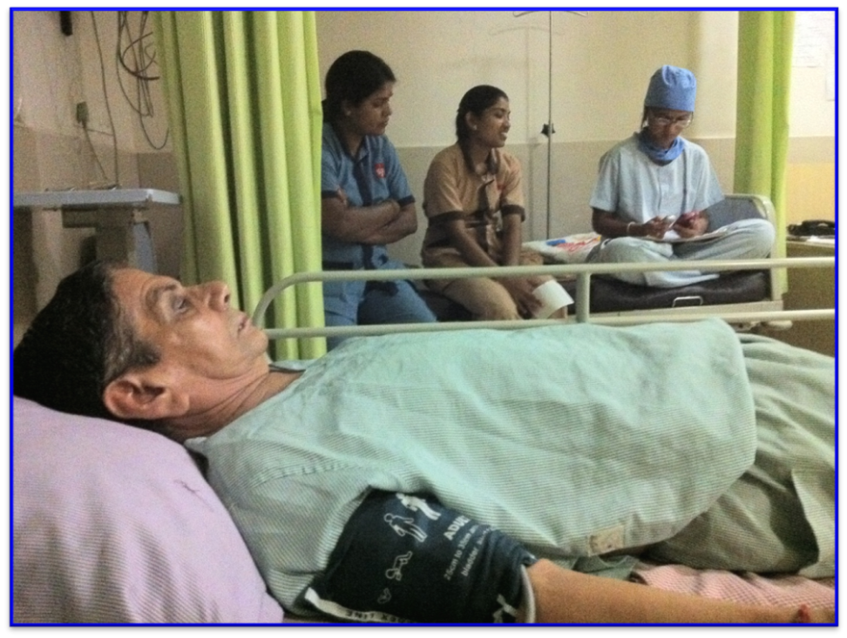
Patient is chanting 45th shloka of BHAKTAMAR STOTRA
An oral cancer patient before surgery

Slide 44
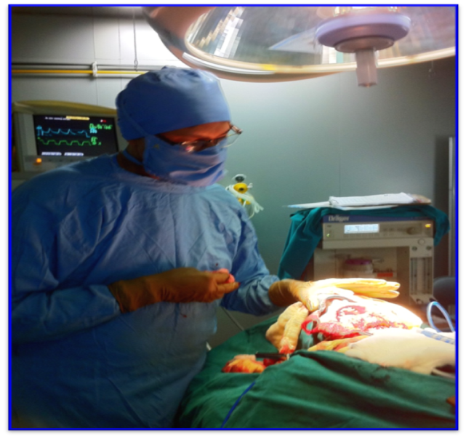
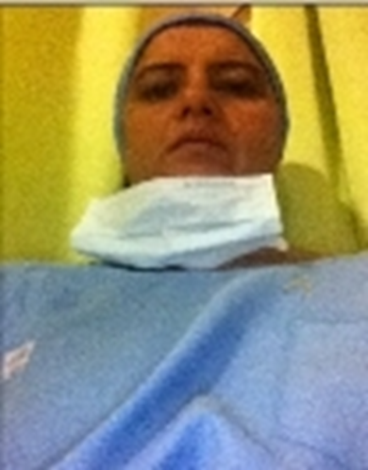
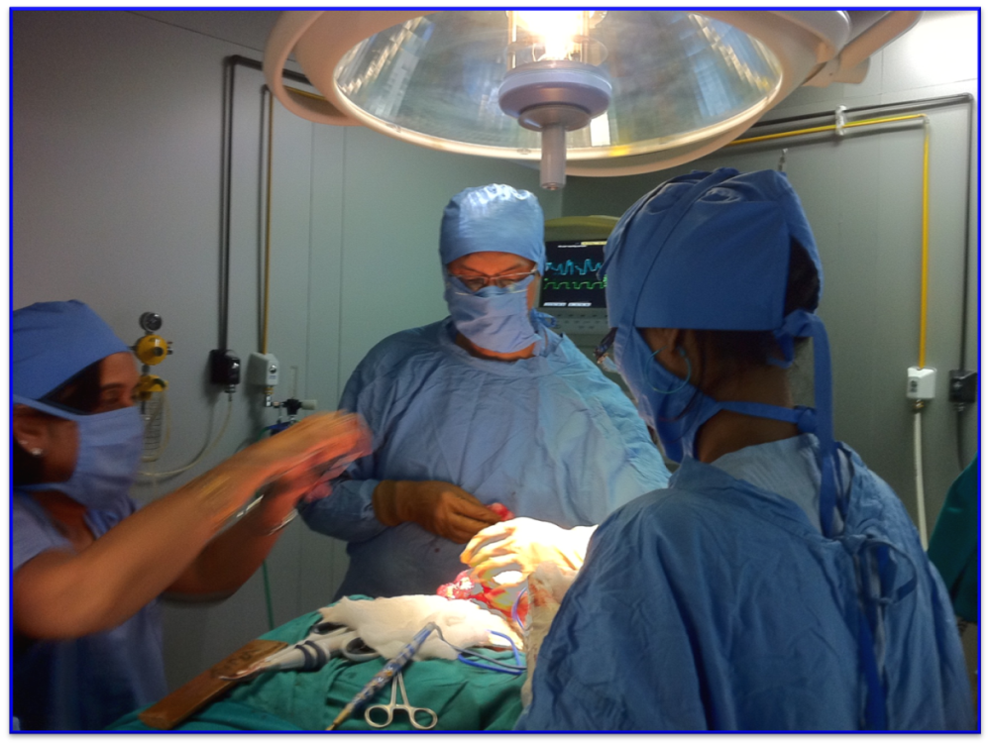
Chanting of Mantra during Mandible surgery
Dr. Manju Jain Chanting Baktammar
Dr. Ajay Mehta during surgery
Dr. Ajay Mehta speaks on spiritual healing

Slide 45
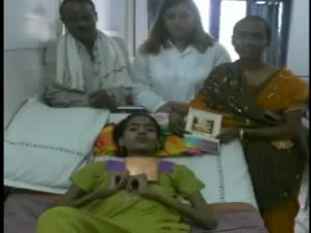
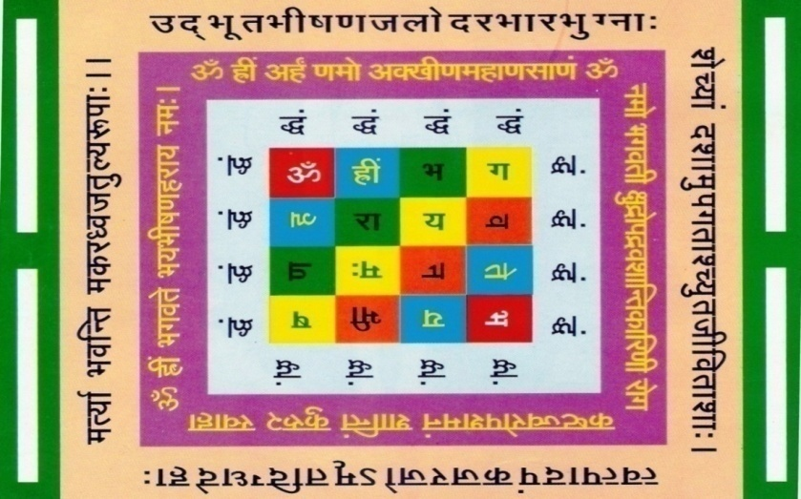
Miss. Kanchan Bhujate, 14 years old,
Acute lymphoblastic leukemia patient brought from Hospice to Central India Cancer Research Institute, Nagpur
Chanting of Mantra by Ms. Kanchan & her parents for 15 days.
Yantra
Om namo Bhagwatī kshudropadrava-shāntikarinī roga kashtajwaropashamanam shātim kuru kuru swāhā
Om hrīm Bhagwaté Bhayabhīshanaharāya namah
Mantra

Slide 46
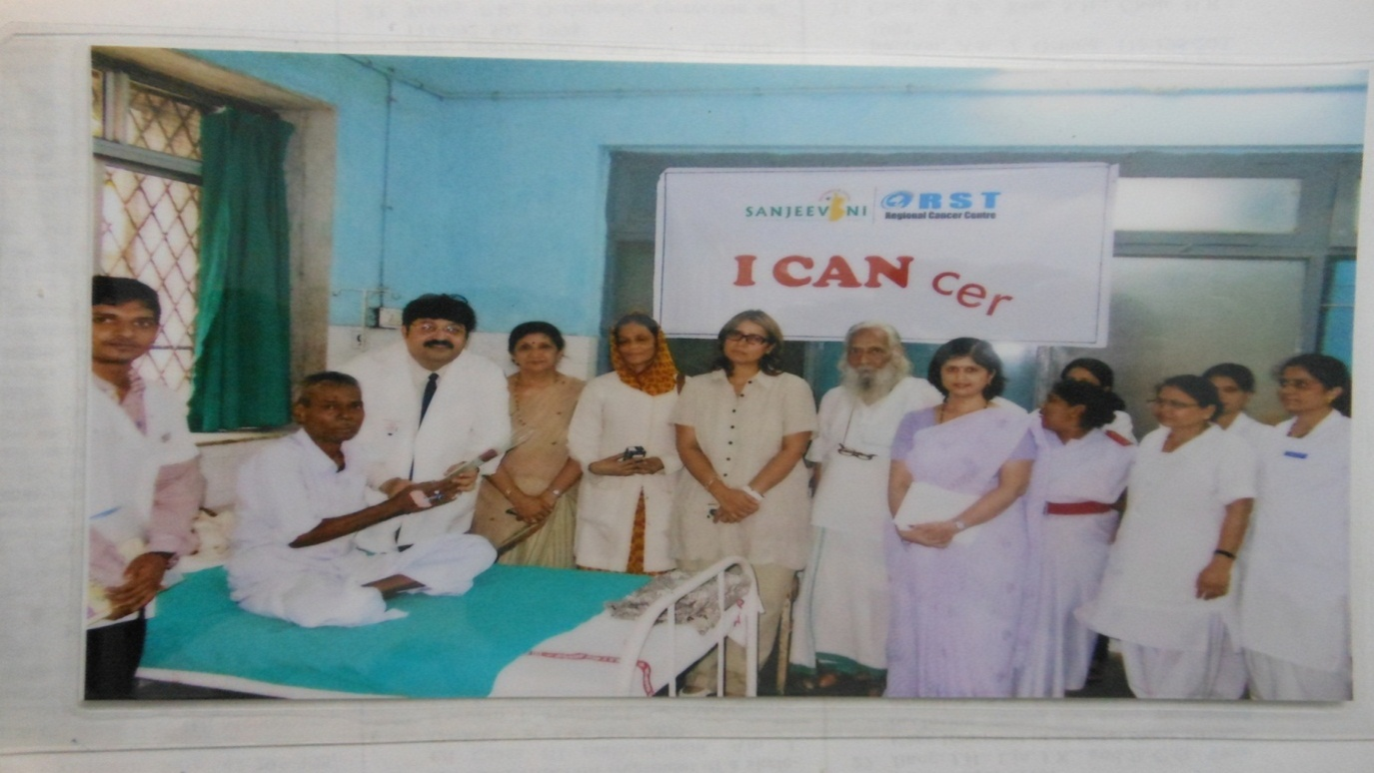
Celebrated Rose day with patient along with Director Dr. Chaudhari.
Regional Cancer Hospital Nagpur, Maharashtra, (India).

