Slide 1
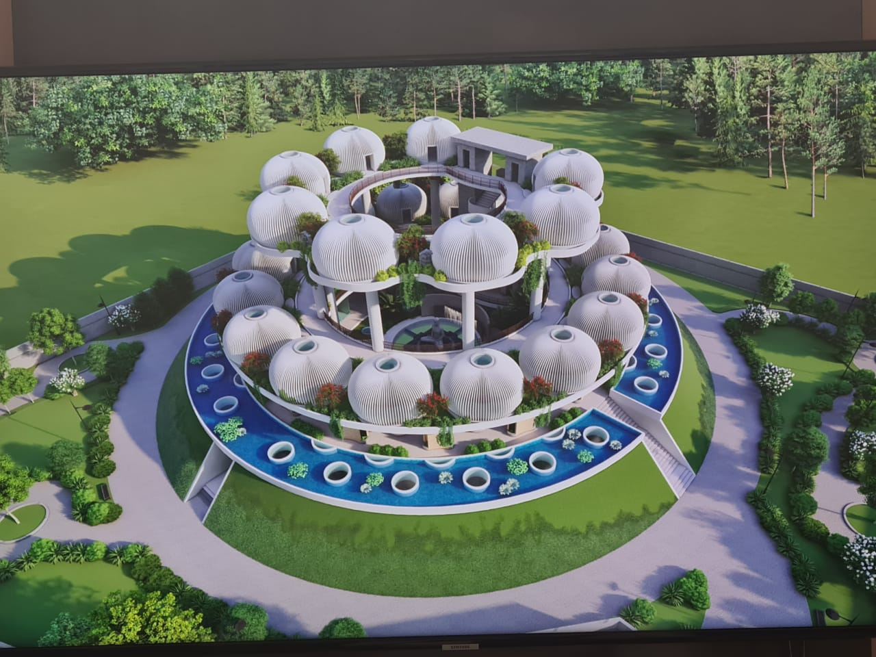
BHAKTAYATAN
BHAKTAYATAN – BHAKTAMAR SPIRITUAL SHRINE

Slide 2
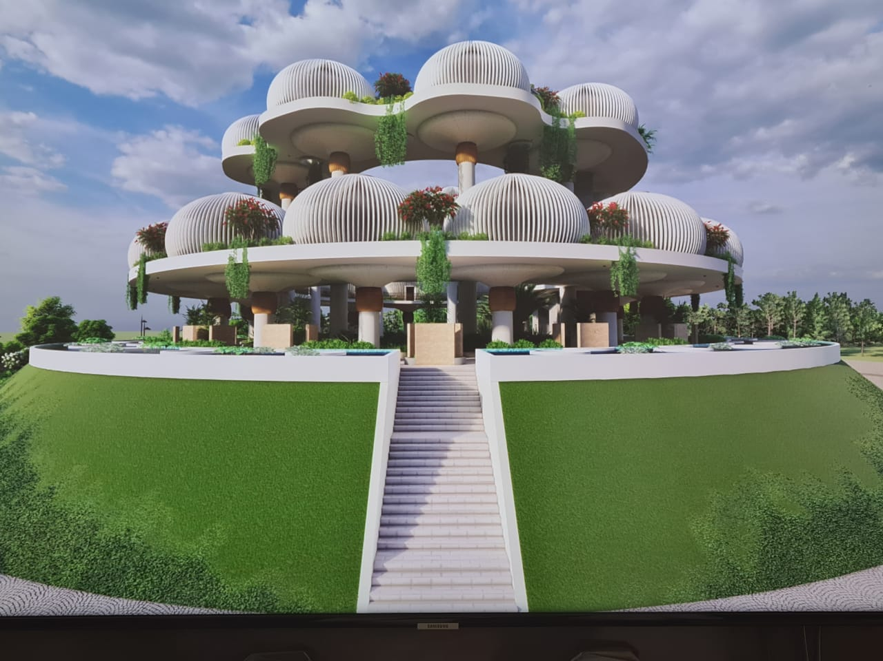
A Need for Bhaktayan – Bhaktamar Divine Shrine
Bhaktayatan is a Bhaktamar Divine Shrine where Bhaktas or Devotees can understand and experience the power of Bhaktamar Stotras or 48 magical tools for manifestation which will increase the consciousness of the committed and deserving seeker and help them achieve in their worldly as well spiritual life irrespective of caste, creed and religion

Slide 3
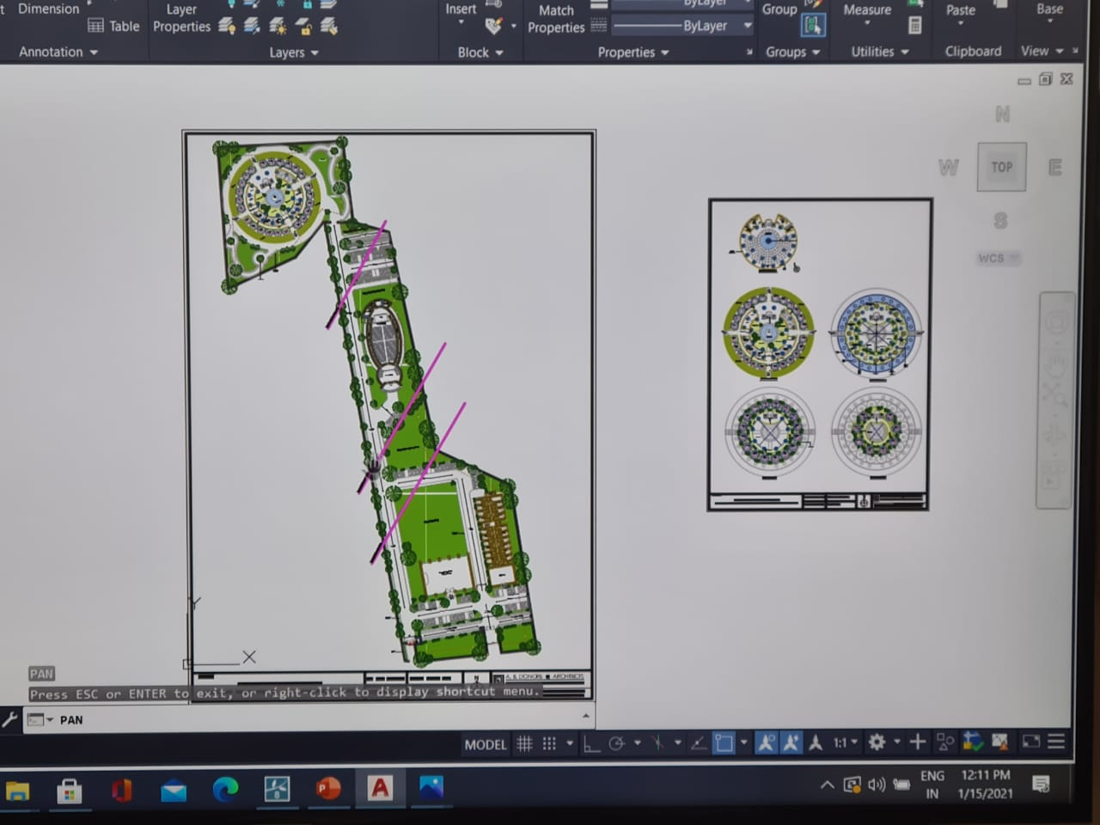
Choice of Location - Nagpur
In Heart of the country lies the city of Nagpur which is zero mile of India and thus very well connected by rail, road and air.
It is coming up on a 16 acre plot which has a very strategic location near Asia’s biggest Godewada international Zoo and Ambedkar Museum for cultural heritage and also in between St Joseph Convent School and Millennium School
Hometown of Dr Manju jain who is regarded as Bhaktamar ki GuruMaa. She has created a very strong team of devotees and healers from Nagpur who are strongly committed towards the cause
As per guidance and blessings of 108 Sant Shiromani Acharya Shri VidyaSagar ji Maharaj and 108 Samay Sagar ji Maharaj
.

Slide 4
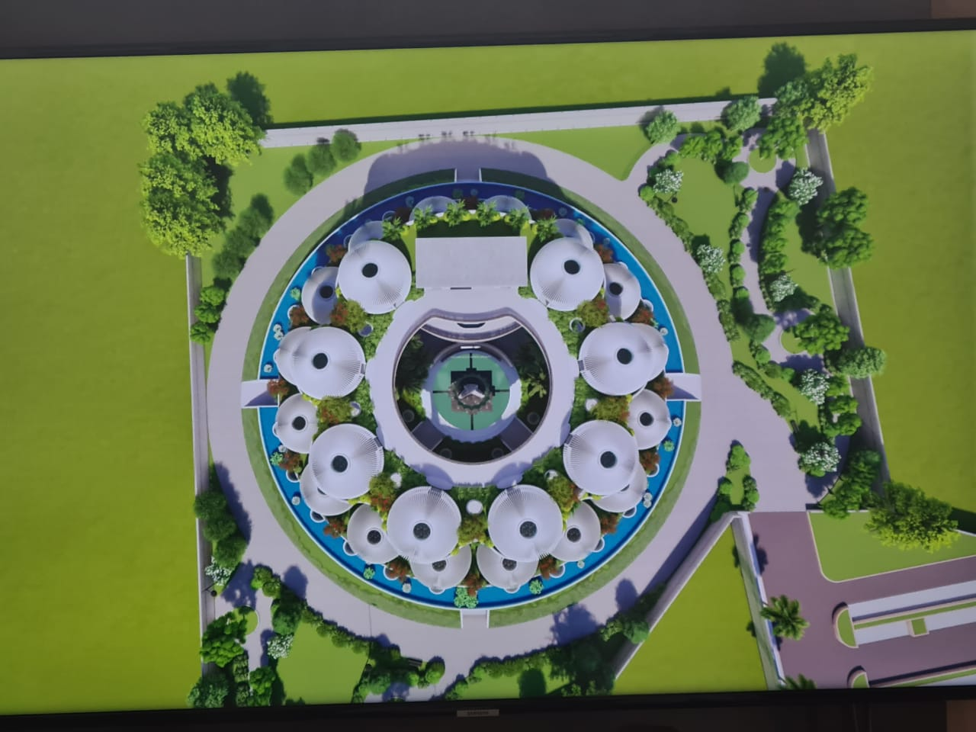
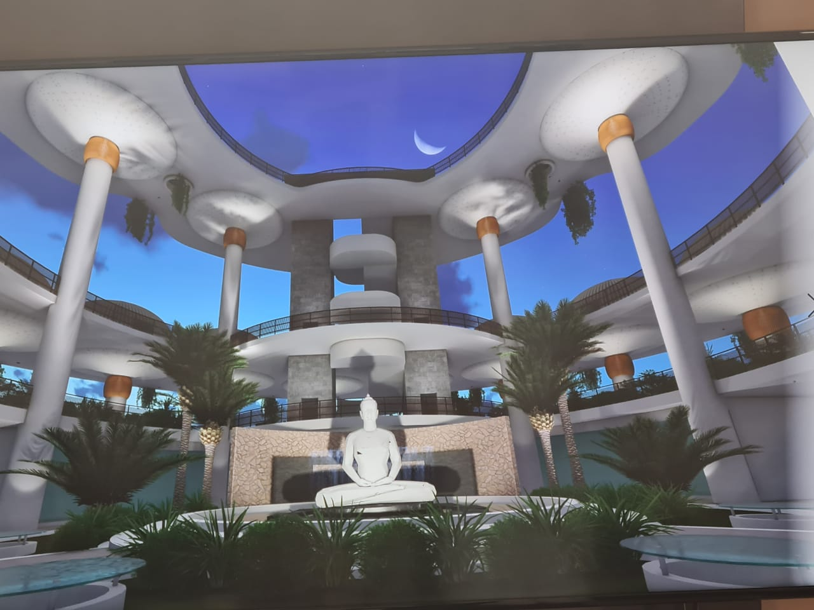
Bhaktayatan – Bhaktamar Divine Shrine Facilities
48 Domes of each Sloka with its pictorial representation with Yantra in pure gold with sunlight falling from the roof

Slide 5
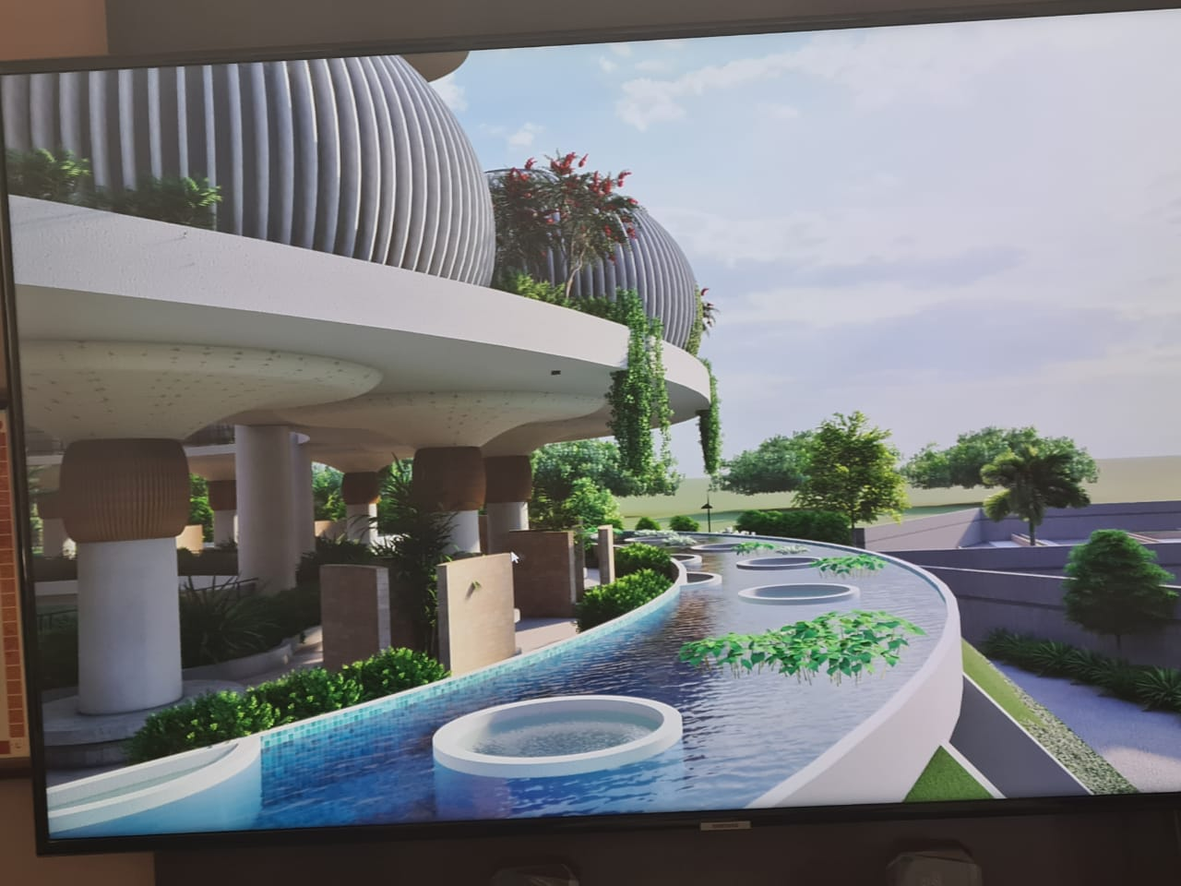
Bhaktayatan – Bhaktamar Divine Shrine Facilities
Each Mushroom Pillar carrying on top Igloos of Bhaktamar Dome

Slide 6
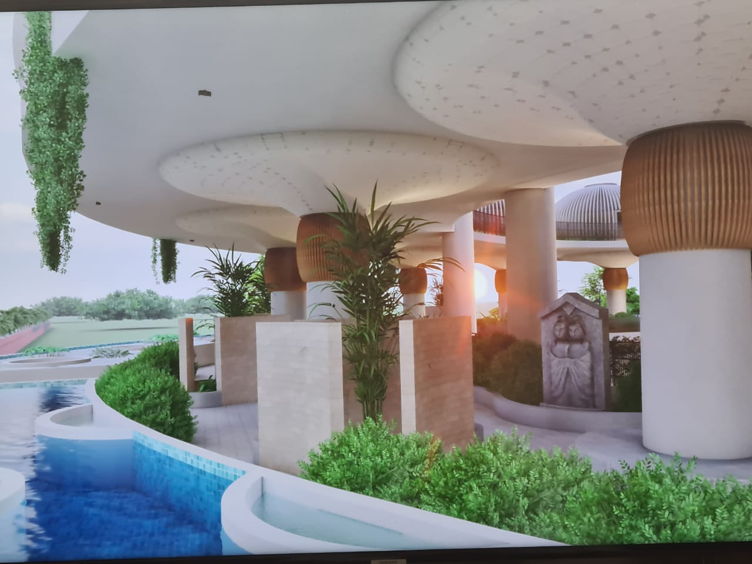
Bhaktayatan – Bhaktamar Divine Shrine Facilities
Shloka Mantra and Riddhi in Sanskrit, English and French in open Art Gallery on Mushroom Pillars

Slide 7
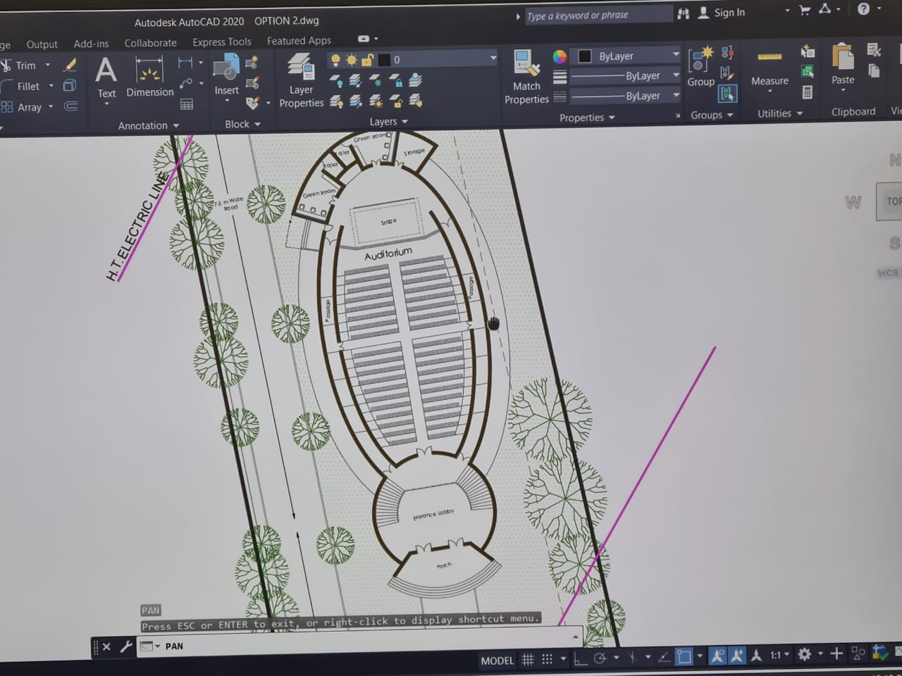
Bhaktayatan – Bhaktamar Divine Shrine Facilities
A fully equipped Auditorium of 250 capacity with state of art acoustics

Slide 8
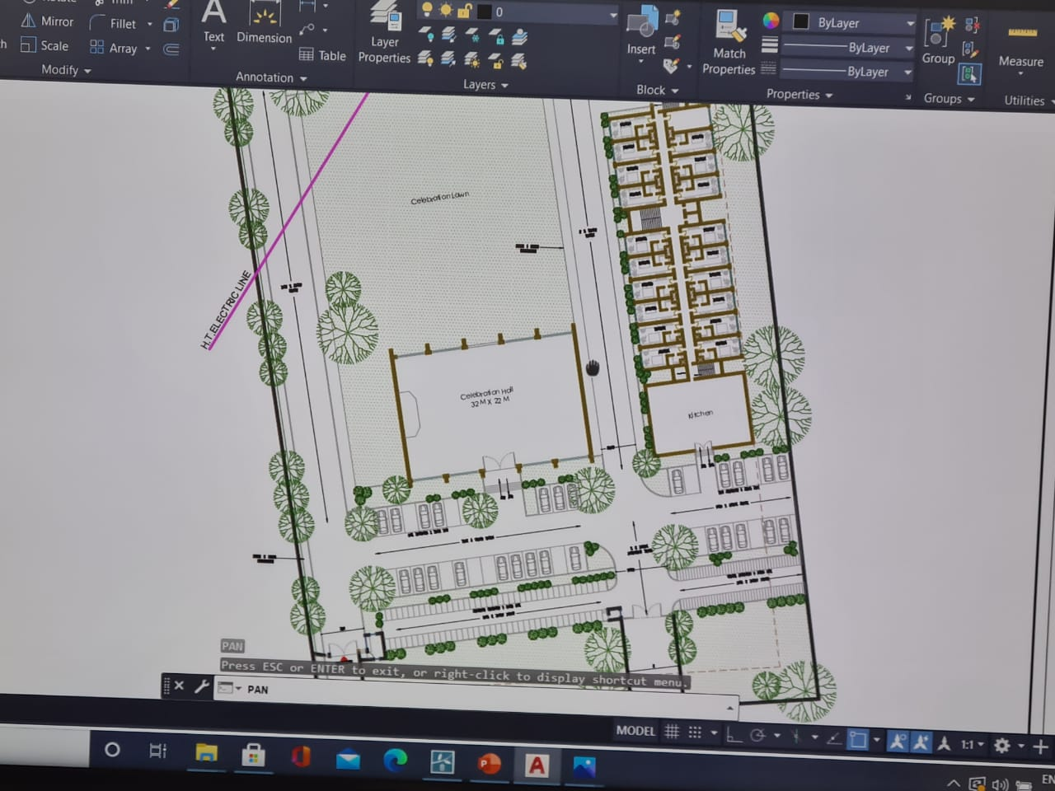
Bhaktayatan – Bhaktamar Divine Shrine Facilities
100 Residential facilities provided with fully furnished flats
Facilities for imparting training, research and higher studies including PhD on Healing Modalities and Energy Medicine
Couselling Centre with trained professional healers
Exhibition Gallery for one to propagate the power of Healing and Energy
Sufficient parking Facilities

Slide 9
The Force Behind……..
Blessings & guidance from 108 Sant Shiromani Acharya Shri VidyaSagar ji Maharaj and 108 Samay Sagar ji Maharaj
Land donated by Shri Rakesh Patni ji
Conceptualisation by Dr Manju Jain
Architectural Planning by Arc. Dongre
Execution planning by Ms Sonal Jain Jayaswal (Siddhayatan)
Prayers from Bhaktamar Healers & Devotees from across the globe

Slide 10
Prayers across the Globe
Charge your Lavangs for 21 days by either chanting complete Bhaktamar Stotra or a particular shloka of your choice.
These charged lavangs will be placed in the Neev of the Shrine.
More than 250 Devotees across the globe have started with their prayers for the successful creation of the Divine Shrine

Slide 11
Get Set Go …………
On the auspicious day of Basant Panchmi 16.2.2021 there will be Akhand Chanting of Bhaktamar Stotras for the cleansing and energizing of the plot under the guidance of Bhatarak ji.
Inviting one and all to be part of this historic event

